Slide 1

BREAST FEEDING, BEST FEEDING
Speaker: Dr. NILAMADHAB JENA, Past PRESIDENT IAP , ODISHA

Slide 2


Slide 3

BREASTFEEDING
Ideal food for the neonate
Ensuring exclusive breastfeeding reduces under-5 mortality
Must be exclusive for 6 months

Slide 4


Slide 5
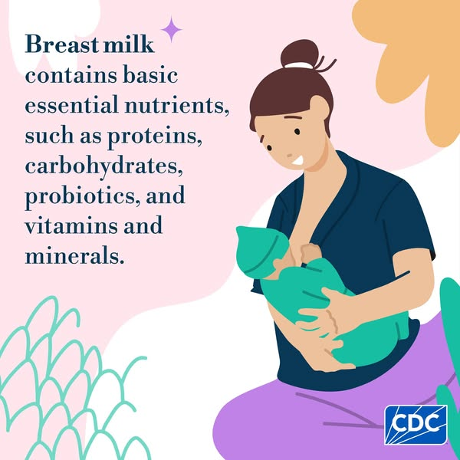
Nutritional superiority
Contains all nutrients
In optimum proportion
In a form easily digested

Slide 6
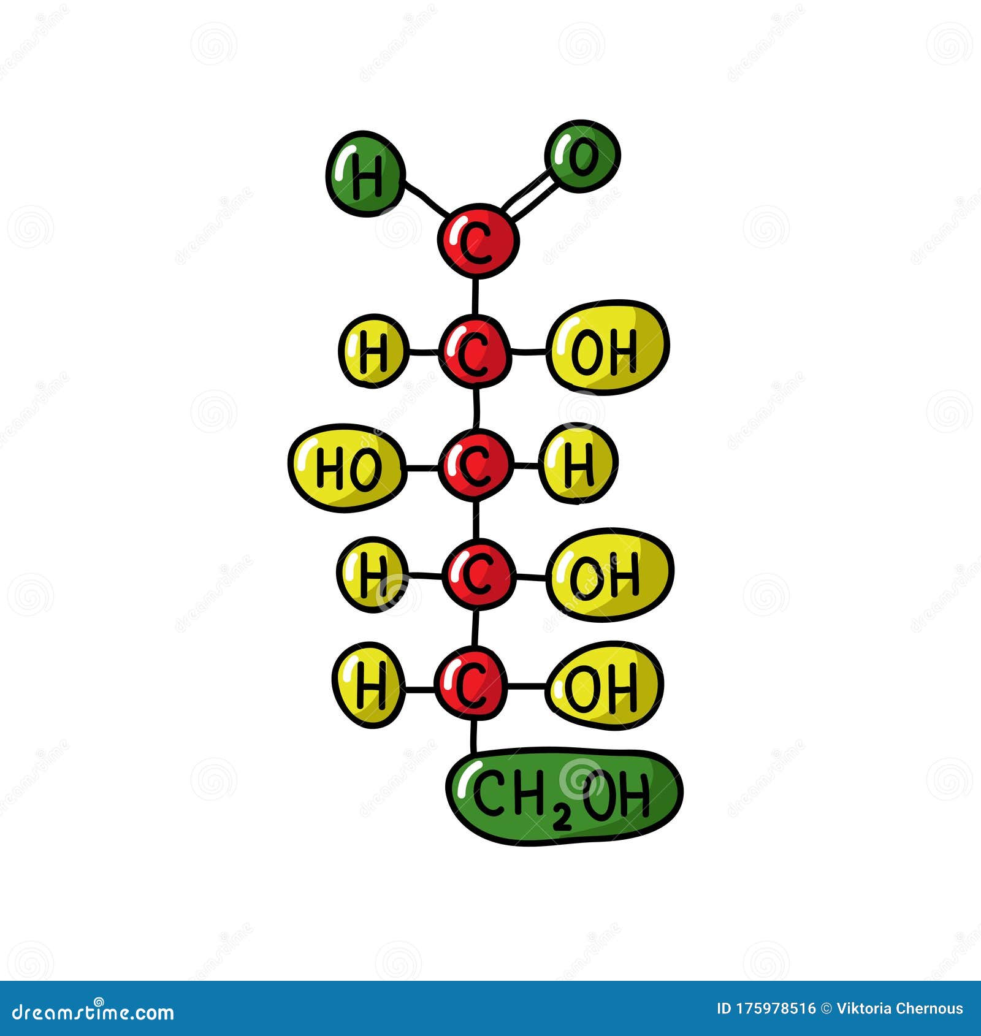
Carbohydrates
Lactose 6-7 g/dL
Helps in the absorption of calcium
and growth of lactobacilli
Galactose for galactocerebrosides

Slide 7

Proteins
0.9-1.1 g/dL
Present in the form of Lactalbumin
and lactoglobulin
Amino acid – taurine and cysteine

Slide 8
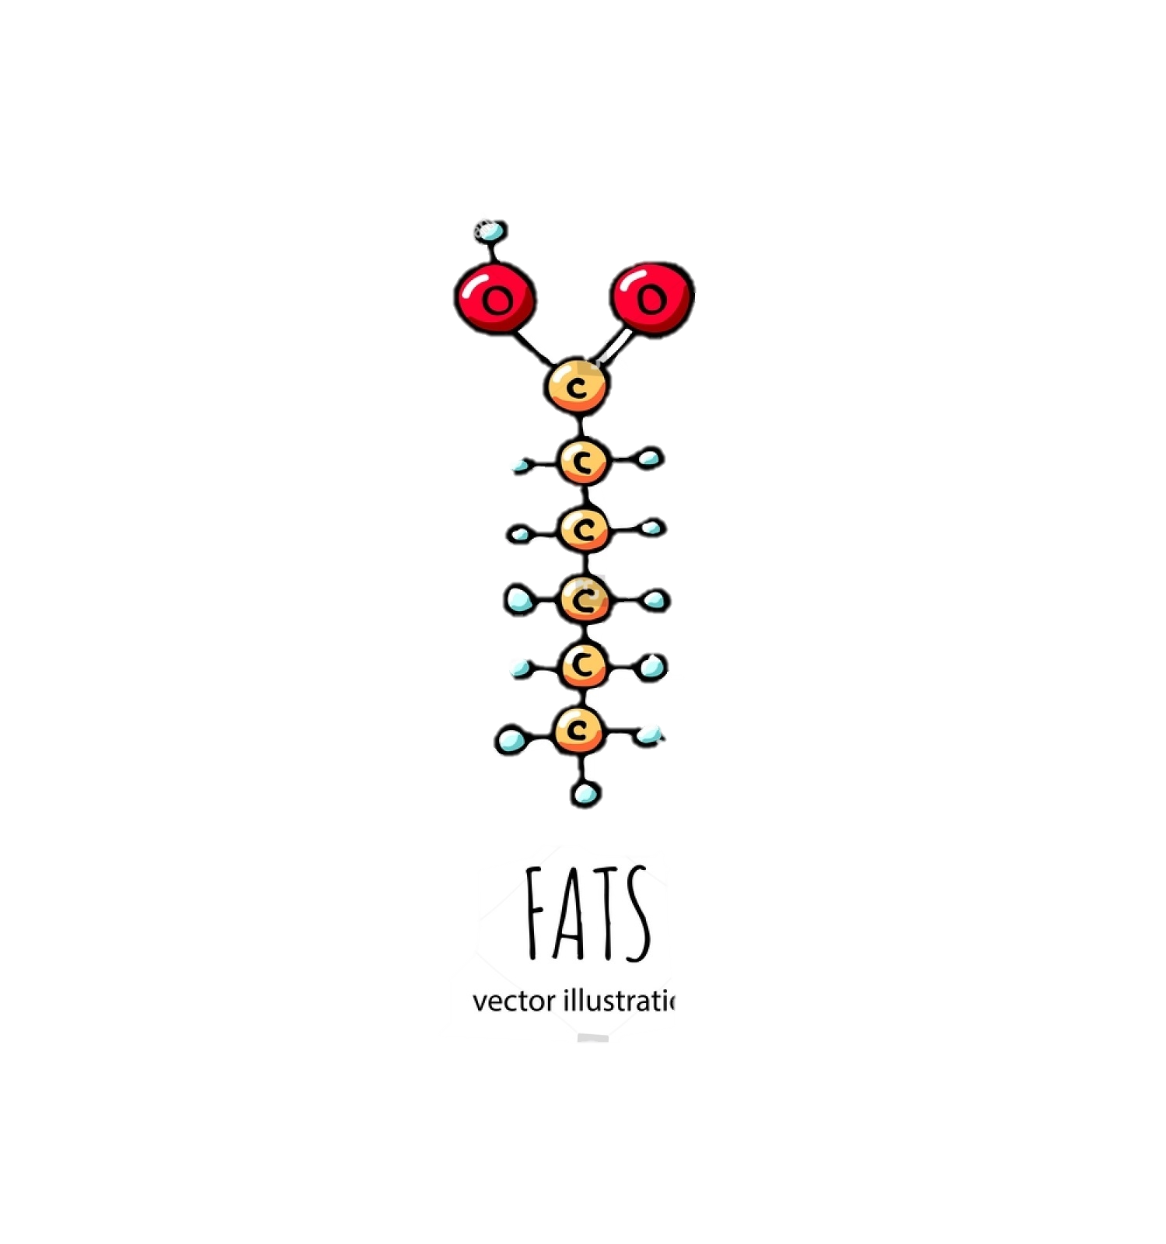
Fats
Polyunsaturated fatty acids help in myelination
Omega-2 and omega-6 help in the formation of prostaglandins and cholesterol

Slide 9

Vitamins and Minerals
Bioavailability
Amount sufficient for baby till 6 months

Slide 10

Water and electrolytes
88 %, does not require additional water
Osmolality is low
Low solute load to kidneys

Slide 11

Immunological superiority
IgA, Macrophages, lymphocytes
Lactoferrin, Lysozyme, Bifidus factor
Less likely to develop infections
Less likely of morbidity due to diarrhoea

Slide 12

Other benefits
Growth factors, enzymes, and hormones
Epidermal growth factors
helps in maturation
of intestinal cells
Lipases – increase the digestion of fats
Protection against other illnesses
Mental growth

Slide 13

BENEFITS TO THE MOTHER
Uterine involution
Lactational amenorrhea
Reduces the risk of breast carcinoma and ovarian carcinoma
Helps to shed extra weight gained during pregnancy

Slide 14
ANATOMY AND PHYSIOLOGY

Slide 15
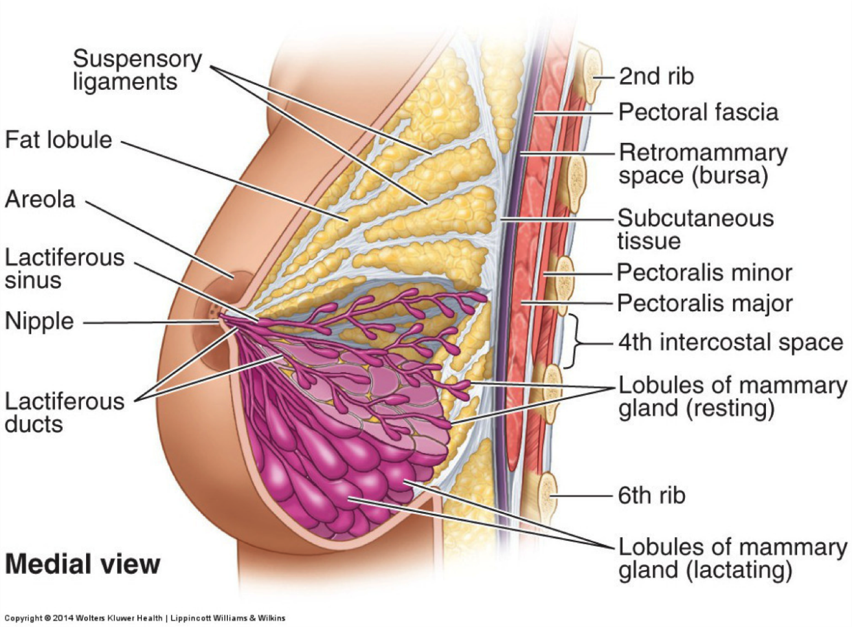
BREAST ANATOMY
Glandular tissue
LOCATION:
-pectoral region
-four quadrants
EXTENT :

Slide 16
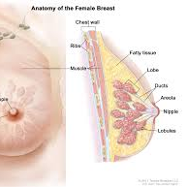
STRUCTURE OF THE BREAST
The skin
-Nipple:
Rich in its nerve supply and has many sensory end organs
-Areola:
Rich in modified sweat glands, Oily secretions-Lubricate, preventing them from cracking

Slide 17
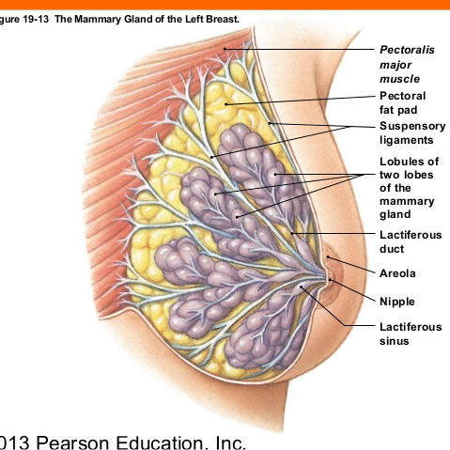
The parenchyma
-Glandular tissue
-15-20 lobes
-Each lobe-cluster of alveoli
-drained by a lactiferous duct
-lactiferous sinus

Slide 18
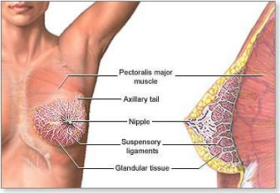
Alveolar epithelium:
Resting phase-cuboidal
Lactation -columnar
Myoepitheliocytes:
The stroma
-fibrous, fatty
-fibrous-----suspensory ligaments of Cooper

Slide 19
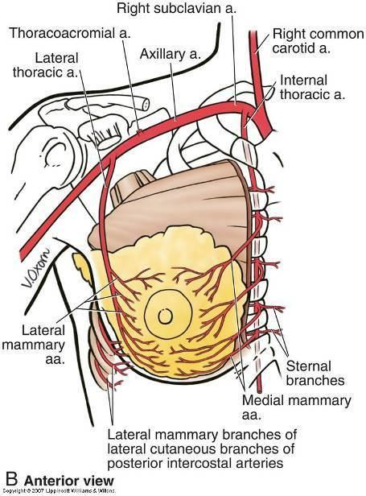
BLOOD SUPPLY
ARTERIAL SUPPLY:
1.Internal thoracic artery
2.Lateral thoracic,superior thoracic,acromiothoracic arteries
3.Lateral branches of posterior
intercostal arteries

Slide 20
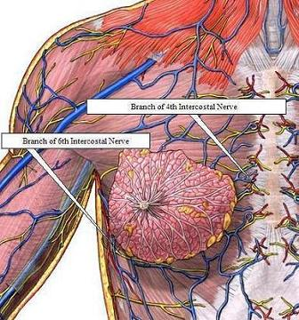
Venous drainage:
Anastomotic venous circle
Nerve supply:
Anterior and lateral cutaneous branches of 4th to 6th intercostal nerves
Nerves do not control the secretion of milk

Slide 21

PHYSIOLOGY OF BREASTFEEDING
Lactogenesis: complex phenomenon
Prolactin reflex
Oxytocin reflex

Slide 22
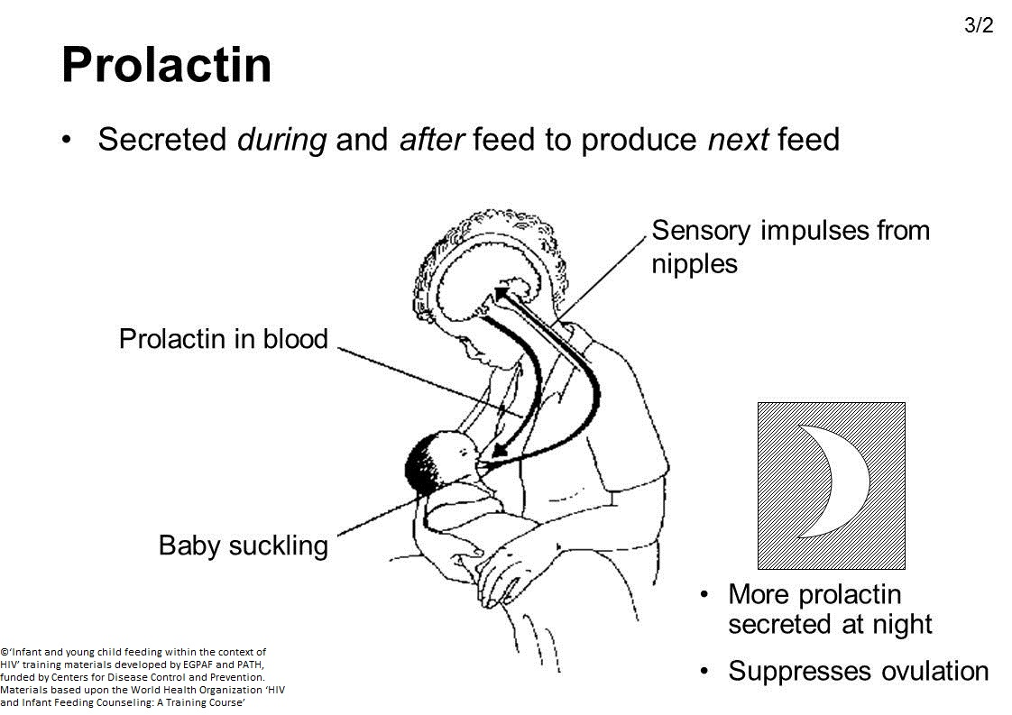
PROLACTIN REFLEX

Slide 23
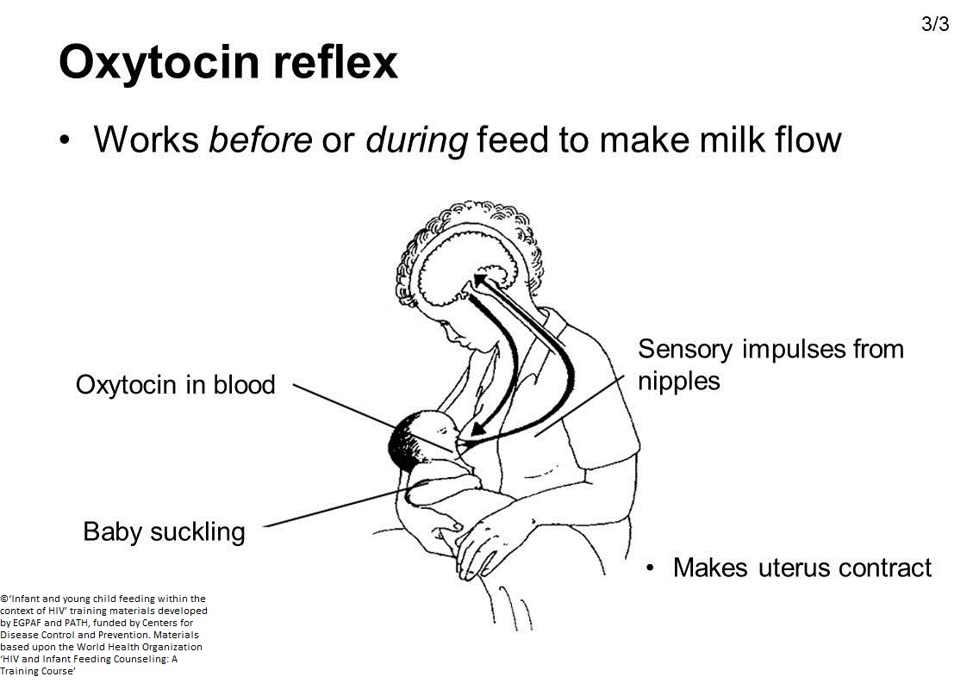
OXYTOCIN REFLEX

Slide 24
FACTORS WHICH REDUCE MILK PRODUCTION
Dummies,pacifiers,bottles
Supplements: sugar water, gripe water, honey, breast milk substitutes
Painful breast conditions:sore,cracked nipples
Lack of night feeding

Slide 25


Slide 26
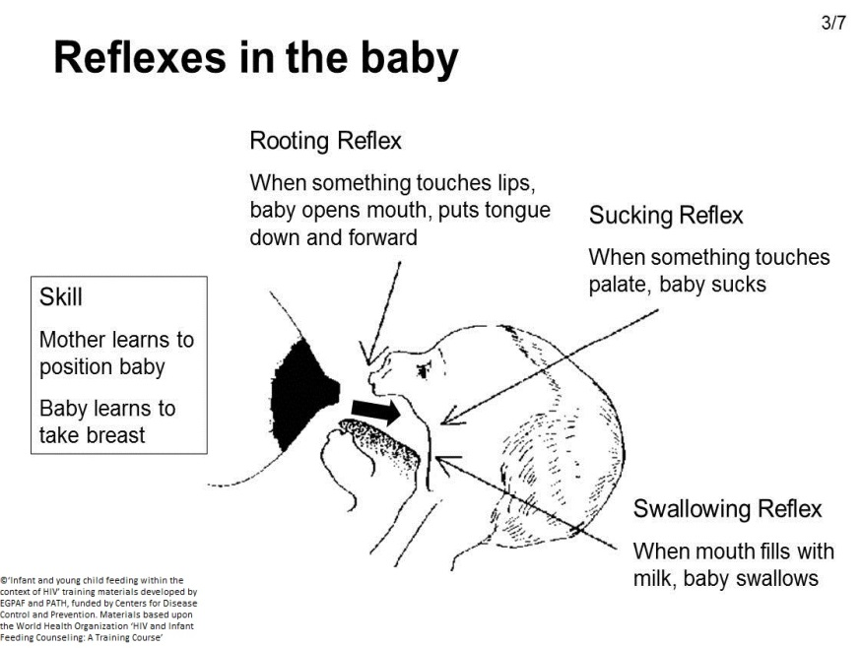
REFLEXES IN THE BABY
The rooting reflex
2. The suckling reflex
3. The swallowing reflex

Slide 27
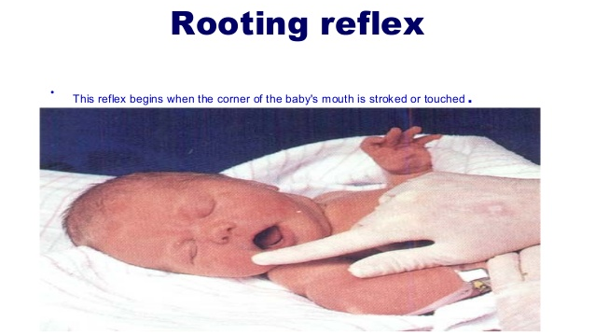
ONSET-28 WEEKS OF IU
WELL, ESTABLISHED-32-34 WEEKS OF IU
DISAPPEARS -3-4 MONTHS

Slide 28
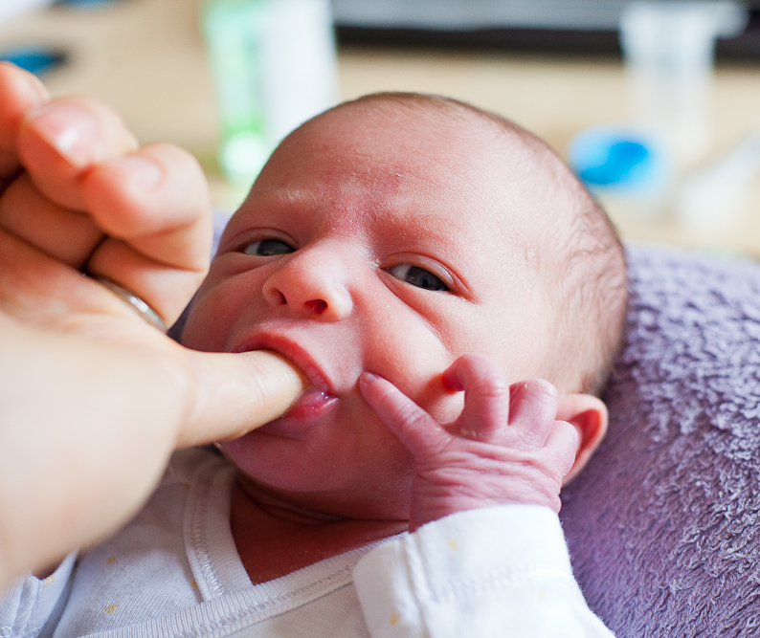
Suckling reflex
APPEAR AT 28 IU
WELL, ESTABLISHED 32-34 WEEKS
DISAPPEARS AT 12 MONTHS

Slide 29
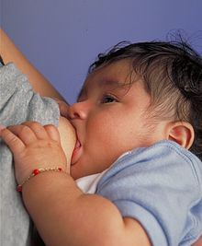
Swallowing reflex
APPEARS AT 12 WEEKS OF IUL
ESTABLISHED AT 32-36 WEEKS OF IU

Slide 30
COMPOSITION OF BREAST MILK (TERM INFANTS)
Components | Mean value (per 100ml)
Energy (KJ) | 280
Energy (kcal) | 67
Protein (g) | 1.3
Fat (g) | 4.2
Carbohydrate (g) | 7.0
Sodium (mg) | 15
Calcium (mg) | 35
Phosphorus (mg) | 15
Iron (mcg) | 76
Vitamin A (mcg) | 60
Vitamin C (mg) | 3.8
Vitamin D (mcg) | 0.01

Slide 31
Variation in composition during different Stages of lactation
The composition of milk changes after the birth of the baby according to the needs
Colostrum
Secreted during the intial 3-4 days after delivery containing more antibodies proteins and vitamins
Transitional milk
Secreted after 3-4 days until 2 weeks containing more fats and sugar content
Mature milk
Which is thinner and watery
What about preterm babies?????

Slide 32
TYPES OF BREAST MILK
Fore milk
secreted at the start of the feed.
is watery and rich in proteins, sugar, vitamins, minerals and water
Hind milk
comes towards the end of feed.
richer in fat content and provides more energy

Slide 33
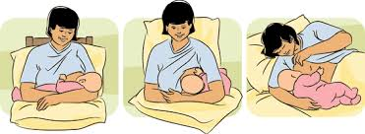
TECHNIQUES OF BREAST FEEDING

Slide 34

TRADITIONAL OR CRADLE HOLD
Sit as straight as possible
Cradle the baby in the arm
The ear, shoulders and hip should be in a straight line.
Tuck the baby's lower arm out of the way, with her mouth close to the breast.
Support the breast with the free hand

Slide 35
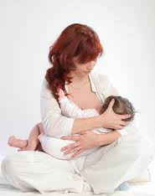
CROSS CRADLE HOLD
This is similar to the previous method except that the baby is cradled with the arm, the baby’s tummy against the mother’s tummy and the hand behind the baby’s head.
The ear, shoulders and hips should be in a straight line.

Slide 36
FOOTBALL OR CLUTCH HOLD
Position the baby so her legs and body are under the arm, with the hand holding her head
Allow the baby to latch-on while pulling the baby close, holding the head tightly against the breast.
Keep the baby's body flexed at the hip with the legs tucked under the arm.

Slide 37
The football hold is a good position when:
There is a caesarean birth
The need for more visibility in getting the baby to latch-on.
The breasts are large.
The baby is very small, especially if premature.
the baby tends to slide down the areola onto the nipple.
the baby is fussy, restless and hard to latch-on.
The baby is sleepy
The mother has inverted nipples.

Slide 38
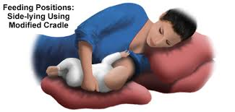
SIDE-LYING POSITION
First, the mother has to position herself and the baby on her sides tummy-to-tummy.
Bend the top leg and position with pillows.
Place the fingers beneath the breast and lift upward, then pull the baby in close as he/she latches-on.

Slide 39
LATCHING ON
Sit or lie tummy-to-tummy with the baby.
Bring the baby close to the breast.
Touch the nipple to the baby's lower lip.
When his/her mouth opens wide, quickly pull your baby in to latch on. Bring the baby towards the breast, not the breast to his/her head.
The baby will be able to breathe even though his/her nose may press against the breast.

Slide 40
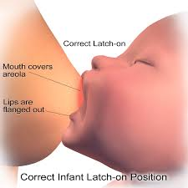
SIGNS OF CORRECT LATCH ON
The baby's mouth should surround the tip of the nipple and about one inch of the areola.
The lips should be turned outward against the breast.
The motion of the suck is along the jaw, not in the cheeks.

Slide 41
SIGNS OF CORRECT LATCH ON
4. Baby's ears, shoulder and hip should be in a straight line.
5. Breastfeeding should not hurt.
6. There should be feel of a rhythmic tug on your breast, and a little bit of nipple tenderness is normal during the learning period.

Slide 42
How to take the baby off your breast after breastfeeding??
Break the suction by slipping the little finger in the corner of the baby's mouth between her gums.
Don't remove the baby from the breast until the suction is released, or sore nipples may result.
The suction is usually quite strong

Slide 43
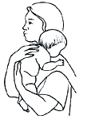
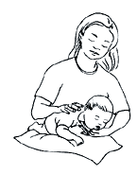
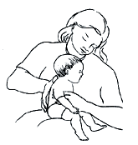
BURPING
Burp the baby after feeding at each breast and at the end of the feeding
When burping the baby, remember to apply some gentle but firm pressure on the abdomen.
Helpful positions to burp include:
Propped up with baby's tummy against the shoulder.
Lying tummy-down across the lap.
Sitting up, leaning over with the supportive hand under baby's arm.

Slide 44
CONTRAINDICATIONS & ALTERNATIVES OF BREAST FEEDING

Slide 45
Breast Feeding may not be the best interest of the baby in following conditons:
Fetal Factors:
Galactosemia.
Maternal Factors:
-active untreated T.B. & H.I.V positive
-T lymphotrophic virus type 1 & 2
-Herpes lesion on breast

Slide 46
Maternal Drugs
Chemotherapy agents & antimetabolites
Drugs of abuse – discontinue breastfeeding until drugs are out of maternal system
Primaquine and Quinine – contraindicated if infant has G6PD

Slide 47
Metronidazole – discontinue breastfeeding until at least 12-24 hours after medication
Sulfa drugs – may be a problem in infants
with jaundice or G6PD, stressed or premature
(can cause kernicterus)
Radioactive isotope – discontinue BF for as long as the radioactivity is in the milk

Slide 48
BENEFITS OUTWEIGHING THE RISKS
• Mother is –
- Hepatitis B surface antigen positive
- infected with Hepatitis C virus
-carrier of cytomegalovirus (except for possibly very low birth weight babies)
• Mother smokes – advise her to give up smoking and not smoke in the home.

Slide 49

Alcoholic Mother–
Occasional drinking –not harmful .
Can breastfeed after 2 hrs of drinking.
Occasionally, in rare cases of hyperbilirubinaemia(breastmilk jaundice) breastfeeding may need to be interrupted temporarily.

Slide 50

ALTERNATIVES OF BREAST FEEDING
i . ) Expressed Breastmilk
ii . ) Wet Nurse
iii . ) Formula
Feeding

Slide 51
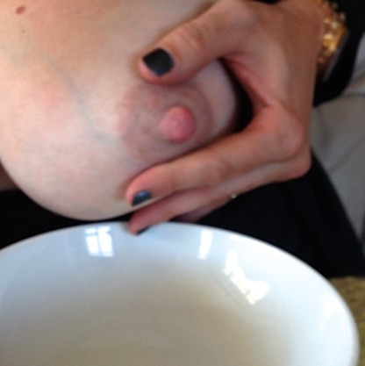
EXPRESSED BREASTMILK
Mother –not in a position to feed her
baby(illmother,preterm baby,working mother)
(OR)
in engorged breasts.
Precautions:
-should in a hygenic conditions
-stored at room temperature
for 10hrs
-In refrigerator for 24 hrs
-In freezer at -20 c for 3 months.

Slide 52
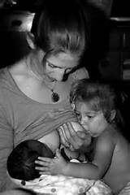

WET NURSE (Donor Milk):
A women who breast
feeds & cares for someones
child.
Advantage :
similar to mothers breastmilk.
Disadvantage:
Screening process and Blood
Test.

Slide 53

ARTIFICIAL /FORMULA FEEDING
Infant formula is a manufactured foood designed and marketed for feeding to
babies and infants under 12
months of age,usually prepared
for bottle -feeding or
cup-feeding from powder (mixed with water) or liquid (with or without additional water).

Slide 54
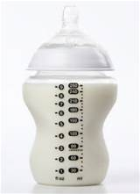
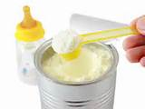
DIFFERENT FORMS OF FORMULA:
Ready to Use
Liquid Concentrate
Powdered.

Slide 55
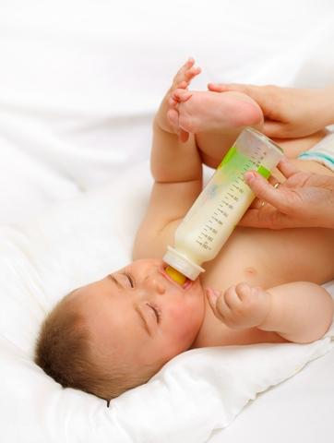
READY TO USE:
Advantage:
- most convenient
- if no access to safe water
Disadvantage:
- expensive
- short lifespan(within 48 hrs)
- more storage space.

Slide 56
Liquid Concentrate Formula:
Advantage:
less expensive than the latter .
less storage space.
Disadvantage:
expensive than powdered
mix equal amount of water.
lining of the cans contain BPA

Slide 57
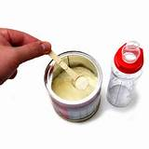
POWDERED FORMULA
Advantage:
- longer life span (1 month)
- less storage space
-canned powdered formula –less BPA
Disadvantage:
- takes time to prepare( acc to instructions.)

Slide 58
TYPES OF FORMULA
Cow's-milk-based formula
Lactose free formula
Soy based formula
Extensively hydrolyzed formula
Formula for premature and low-birth-weight babies

Slide 59
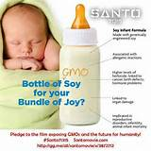

ADVANTAGE OF FORMULA FEEDING
Safe
Bacteria Free
Scientifically prepared
Can be Fortified
Simple to reconstitute

Slide 60
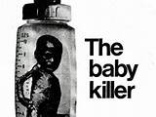
DISADVANTAGE OF FORMULA FEEDING
Must follow the instructions
properly
More dilution (to save money)
Dirty bottles &Nipples can kill
the baby.
Cannot kept in room temperature
for >2 hrs.

Slide 61
MYTHS ABOUT BREASTFEEDING

Slide 62
MYTHBUSTERS
Colostrum is dirty and should not be given
If babies feed a lot they aren't getting enough milk
Formula fed babies sleep better
Breastfeeding is painful
Never wake a sleeping baby to breastfeed
Breastfeeding prevents you from becoming pregnant
You cant breastfeed after breast surgery

Slide 63
COLOSTRUM
In many cultures throughout the world infants are not given colostrum because it is believed to be dirty and unclean
In many countries around the world, especially in Asia, babies are given tea and sugar water for the first few days.
Colostrum is actually liquid gold
Helps protect gut from harmful substances, easy to digest and has a laxative effect.
It is also high in white blood cells and antibodies which help fight infection.

Slide 64

IF BABIES FEED A LOT…
…that means they aren’t getting enough milk
Breast milk is easier to digest because of their high protein low fat content.
Babies being breastfed get hungrier sooner.
So babies that breastfeed usually eat every two to three hours

Slide 65

FORMULA FED BABIES…
…sleep better
Research shows formula fed babies sleep longer.
Due to formula milk taking longer time to digest
Formula milk stays in the baby’s system longer, it begins to ferment.
The result…

Slide 66
BREASTFEEDING…
…is painful
Mother’s nipples may feel tender for the first couple of weeks
But if baby is latching properly, there is no real pain or soreness
It’s important to go to the hospital and get advice from the doctor about correct breastfeeding techniques

Slide 67
NEVER WAKE A SLEEPING…
…baby to breastfeed
Actually the baby will wake you to when he/she is ready to eat.
Time period is usually two and half to three hours.
Baby may also feed vigorously for two to three hours, known as “cluster feedings”.
Should never sleep for more than four and half hour period per day

Slide 68

BREASTFEEDING PREVENTS YOU..
…from becoming pregnant
Breastfeeding isn’t a guaranteed birth control
Up to 98% effective as other method of birth control
Hormones involved in breastfeeding prevent ovulation from 6months up to 14 months.

Slide 69
YOU CAN’T BREASTFEED…
…after surgery
In the western world some have breast implants.
These surgeries often don’t involve incisions on the underside of the breast, so it doesn’t effect milk production or delivery.
Women who have undergone breast reduction surgery on the other hand have it more difficult, especially if never ending around the nipple have been cut

Slide 70
TRUTH
Protection against Post Partum Depression
Studies show that women who breastfeed were less likely to be diagnosed with post partum depression.
Researchers suspect oxytocin a “feel-good” hormone produced when a baby nurses.
If breast feeding is going on well mothers have a confidence that they can provide for the baby

Slide 71

TRUTH
It helps you shed baby weight
Mothers who breastfeed loose about 300-500 extra calories a day compared those who formula feed.
It releases hormones that trigger uterus to return to its pre baby size and weight faster.

Slide 72

PROBLEMS IN BREASTFEEDING
Notes:
Breastfeeding difficulties refers to problems that arise from breastfeeding, the feeding of an infant or young child with milk from a woman's breasts. Although babies have a sucking reflex that enables them to suck and swallow milk, and although human breast milk is usually the best source of nourishment for human infants,^{[1]} there are circumstances under which breastfeeding can be problematic, or even, in rare instances, contraindicated.
Difficulties can arise both in connection with the act of breastfeeding and with the health of the nursing infant

Slide 73
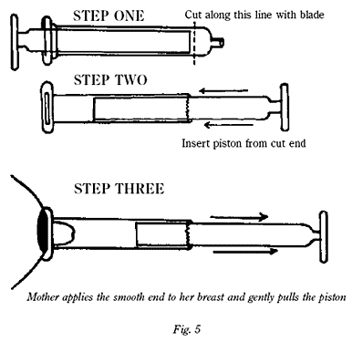
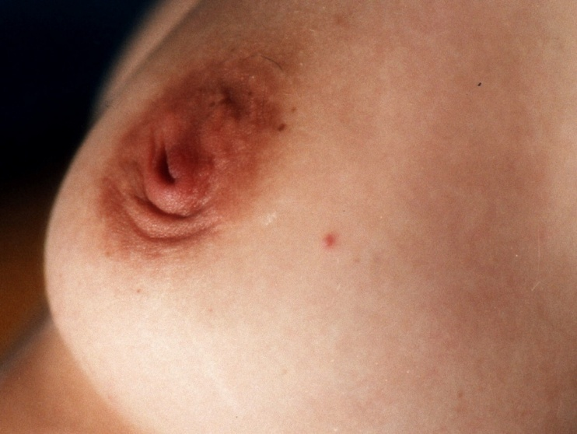
INVERTED NIPPLE
Make difficulty in attachment
Improper suckling may cause sore and excoriated nipple
Treatment:
Manual eversion
Plastic syringe
Nipple Shield
Notes:
Inverted nipple
From Wikipedia, the free encyclopedia
Jump to: navigation, search
Inverted nipple Breast with an inverted nipple.
Classification and external resourcesICD-10N64.5, O92.0ICD-9611.8An inverted nipple (occasionally invaginated nipple) is a condition where the nipple, instead of pointing outward, is retracted into the breast. In some cases, the nipple will be temporarily protruded if stimulated, but in others, the inversion remains regardless of stimulus. Women and men can have inverted nipples.
Contents
[hide]
1 Causes
2 Grading system
3 Pregnancy and breastfeedivng
4 Surgery
5 Piercing
6 Other corrective strategies
7 References
8 External links
Causes[edit]
The most common causes of nipple inversion include:
Born with condition
Breastfeeding
Trauma which can be caused by conditions such as fat necrosis, scars or it may be a result of surgery
Breast Sagging, Drooping or Ptosis
Breast cancer including breast carcinoma, Paget's disease and Inflammatory Breast Cancer (IBC)
Breast infections or inflammations such as mammary duct ectasia, breast abscess or mastitis
Genetic variant of nipple shape such as Weaver syndrome, Fryns-Aftimos syndrome, Chromosome 2q Deletion or congenital disorder of glycosylation type 1A & 1 L or Kennerknecht-Sorgo-Oberhoffer syndrome
Gynecomastia^{[1]}
Holoprosencephaly, recurrent infections, and monocytosis
Pregnancy
Tuberculosis^{[2]}
Around 10–20% of all women are born with this condition.^{[3]} Most common nipple variations that women are born with are caused by short ducts or a wide areola muscle sphincter.
Inverted nipples can also occur after sudden and major weight loss.
One Inverted Nipple and one erect nipple
Grading system[edit]
There are three grades of inverted nipples, defined on how easily the nipple may be protracted and the degree of fibrosis existent in the breast as well as the damage it has caused on the milk ducts.
Inverted nipple Grade 1 refers to nipples that can easily be pulled out, by using finger pressure around the areola. The Grade 1 inverted nipple maintains its projections and rarely retracts. Also, Grade 1 inverted nipples may occasionally pop up without manipulation or pressure.^{[4]} Milk ducts are usually not compromised and breast feeding is possible. These are "shy nipples".^{[5]} It is believed to have minimal or no fibrosis. There is no soft-tissue deficiency of the nipple. The lactiferous duct should be normal without any retraction.^{[6]}
Inverted nipple Grade 2 is the nipple which can be pulled out, though not as easily as the Grade 1 inverted nipple but which retracts after pressure is released. Breast feeding could be possible even though it is more likely to be either very difficult or impossible. Grade 2 nipples have a moderate degree of fibrosis. The lactiferous ducts are mildly retracted but do not need to be cut for the release of fibrosis. On histological examination, these nipples have rich collagenous stromata with numerous bundles of smooth muscle. Most women with this problem suffer from inverted nipples Grade 2.
Inverted nipple Grade 3 describes a severely inverted and retracted nipple which can rarely be pulled out physically and which requires surgery in order to be protracted. Milk ducts are often constricted and breast feeding is impossible. Women with Grade 3 inverted nipples may also struggle with infections, rashes, or problems with nipple hygiene. The fibrosis is remarkable and lactiferous ducts are short and severely retracted. The bulk of soft tissue is markedly insufficient in the nipple. Histologically, there are atrophic terminal duct lobular units and severe fibrosis.
Pregnancy and breastfeeding[edit]
Individuals with inverted nipples may find that their nipples protract (come out) temporarily or permanently during pregnancy, or as a result of breastfeeding. Most women with inverted nipples who give birth are able to breastfeed without complication, but inexperienced mothers may experience higher than average pain and soreness when initially attempting to breastfeed. When a mother uses proper breastfeeding technique, the infant latches onto the areola, not the nipple, so women with inverted nipples are actually able to breastfeed without any problem. An infant that latches on well may be able to slush out an inverted nipple. The use of a breast pump or other suction device immediately before a feeding may help to draw out inverted nipples. A hospital grade electric pump may be used for this purpose. Some women also find that using a nipple shield can help facilitate breastfeeding. Frequent stimulation such as sexual intercourse and foreplay (such as nipple sucking) also helps the nipple protract.
Surgery[edit]
Before and after inverted nipple repair
Plastic surgery is one method of protracting inverted nipples. If a woman elects to have this surgery performed on her inverted nipples, it can permanently destroy her capacity to breastfeed. Although surgery is normally performed as outpatient procedures and patients are able to go home after few hours following the surgery, some women may be asked to remain in the hospital overnight. However, the patients are advised to avoid driving immediately after the procedure because they will be still under the effect of anesthesia; therefore it is best to be driven home by a friend or relative. The main side effects of surgery are pain, swelling and sensitivity in the nipple area which can last for up to two weeks after the procedure has been performed.^{[7]}
Recovery time is however different with each patient. Patients are encouraged to move around immediately after surgery and after they get home they are recommended to stay in bed for 2 days following the procedure. Patients can generally go back to work in a week after the surgery.
Immediately after the procedure the nipples will more likely feel sore. The soreness should diminish however within few days. Most of the time, patients are prescribed pain killers to help them cope with the discomfort.
Medicated gauze is used following the surgical procedure to cover the nipples. They have the aim to protect the small stitched incisions on the nipple. Patients may feel a little groggy as a side effect of the surgery, but this feeling is expected to subside within a day or so. Patients are recommended not to shower the same day when the surgery was performed, but the next day.
Patients normally experience mild to moderate swelling which peaks two or three days after the procedure, and then disappears rapidly over the following three weeks.^{[8]} Bruising is rare. The sutures are removed four days after the procedure.
Risks that are carried by this type of surgery include infection, unsatisfactory results, excessive bleeding, adverse reaction to anesthesia, and the need for second or sometimes third procedures. The ability to breastfeed cannot be guaranteed after any surgery to correct inverted nipples. Therefore, the patient should clearly specify if she takes into consideration having babies in the future and breastfeeding them.^{[9]}
Piercing[edit]
Another method of protracting inverted nipples is to have the nipple pierced. This method will only be effective if the nipple can be temporarily protracted. If pierced when protracted, the jewelry may prevent the nipple from returning to its inverted state. The success of both of these methods, from a cosmetic standpoint, is mixed.^{[citation needed]}
Other corrective strategies[edit]
Other strategies for protracting inverted nipples include regularly stimulating the nipples to a protruding state, in an attempt to gradually loosen the nipple tissue. Some sex toys designed for nipple stimulation, such as suction cups or clamps may also cause inverted nipples to protract or stay protracted longer. There are special devices specifically designed to draw out inverted nipples or a home-made nipple protractor can be constructed out of a 10 ml disposable syringe. These methods are often used in preparation for breast-feeding, which can sometimes cause inverted nipples to become protracted permanently.
Two methods which are now discouraged are breast shells and the Hoffman technique. Breast shells may be used to apply gentle constant pressure to the areola to try to break any adhesions under the skin that are preventing the nipple from being drawn out. The shells are worn inside the bra. The Hoffman technique is a nipple stretching exercise that may help loosen the adhesions at the base of the nipple when performed several times a day. Although both techniques are heavily promoted, a 1992 study found that not only do shells and the Hoffman technique not promote more successful breastfeeding, but they may also actually disrupt it.[

Slide 74
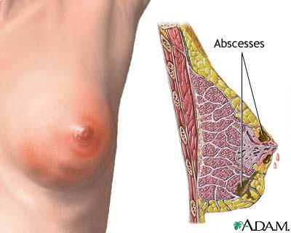
SORE NIPPLE
Causes
Improper latching
Frequent washing with soap and water
Pulling of baby while still suckling
Treatment:
proper positioning and latching
local hygiene
expose to air ,application of breast milk or lanolin , use nipple shield

Slide 75
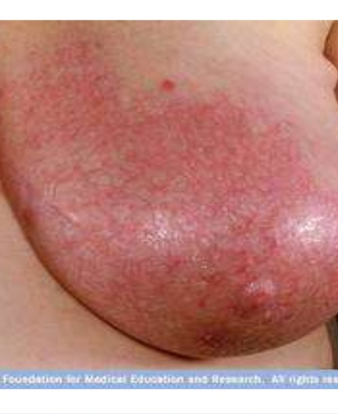
BREAST ENGORGEMENT
CAUSES
Delayed or infrequent feeding
Improper latching and positioning
Engorged breast: swollen, hard ,warm and painful
Notes:
Engorgement[edit]
Breast engorgement is the sense of breast fullness experienced by most women within 36 hours of delivery. Normally, this is a painless sensation of "heaviness". Breastfeeding on demand is the primary way of preventing painful engorgement.
When the breast overfills with milk it becomes painful. Engorgement comes from not getting enough milk from the breast. It happens about 3 to 7 days after delivery and occurs more often in first time mothers. The increased blood supply, the accumulated milk and the swelling all contribute to the painful engorgement.^{[15]} Engorgement may affect the areola, the periphery of the breast or the entire breast, and may interfere with breastfeeding both from the pain and also from the distortion of the normal shape of the areola/nipple. This makes it harder for the baby to latch on properly for feeding. Latching may occur over only part of the areola. This can irritate the nipple more, and may lead to ineffective drainage of breast milk and more pain. Engorgement may begin as a result of several factors such as nipple pain, improper feeding technique, infrequent feeding or infant-mother separation.
To prevent or treat engorgement, remove the milk from the breast, by breastfeeding, expressing or pumping. Gentle massage can help start the milk flow and so reduce the pressure. The reduced pressure softens the areola, perhaps even allowing the infant to feed. Warm water or warm compresses and expressing some milk before feeding can also help make breastfeeding more effective. Some researchers have suggested that after breastfeeding, mothers should pump and/or apply cold compresses to reduce swelling pain and vascularity even more. One published study suggested the use of "chilled cabbage leaves" applied to the breasts. Attempts to reproduce this technique met with mixed results.^{[16]} Non-steroidal anti-inflammatory drugs or paracetamol (acetominophen) may relieve the pain

Slide 76
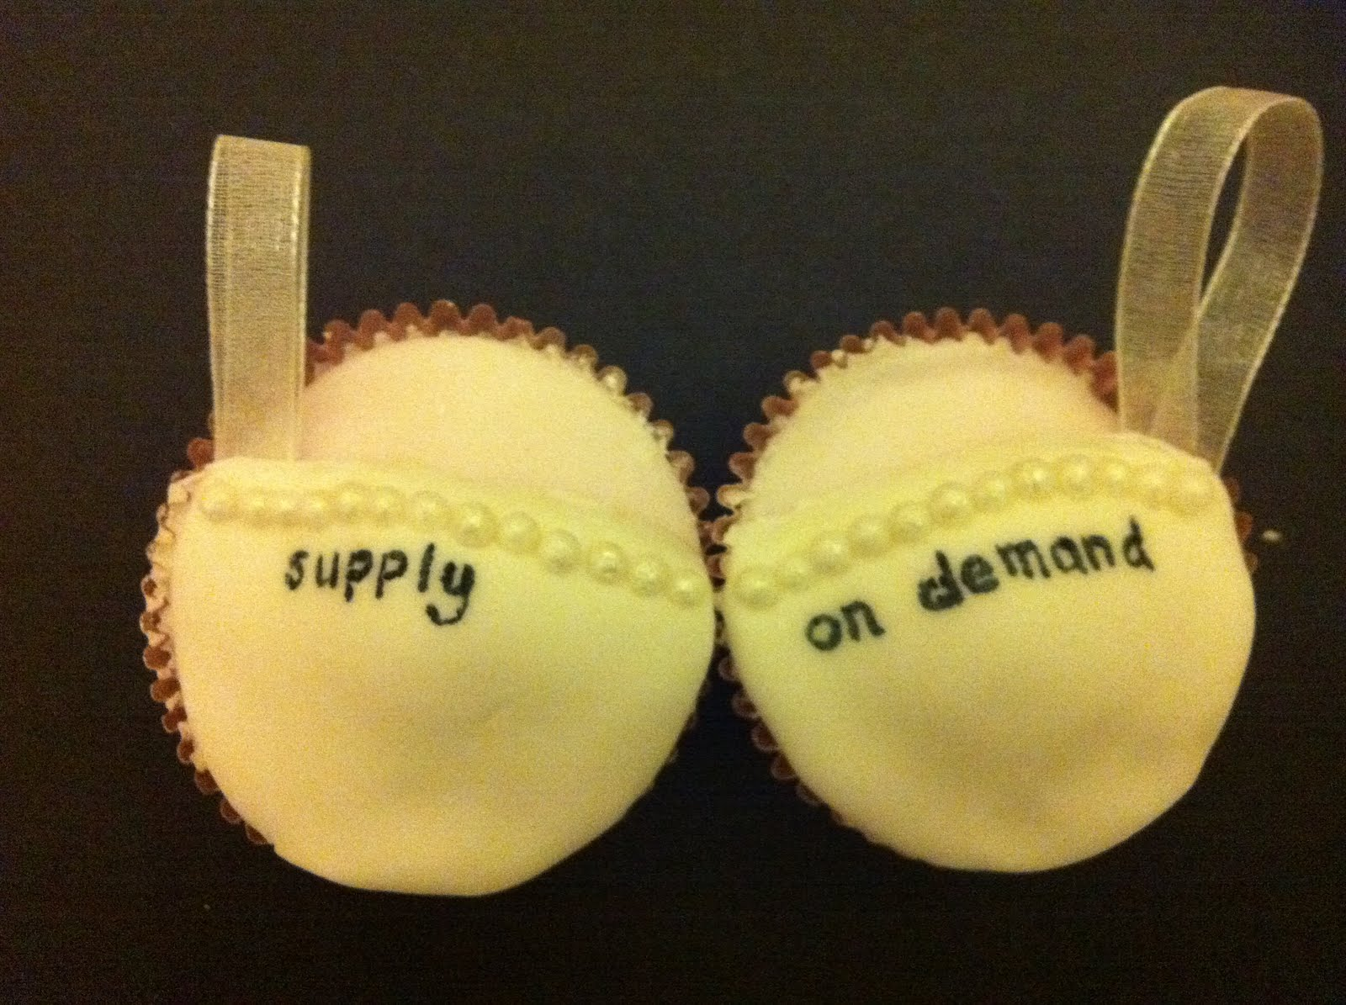
BREAST ENGORGEMENT
Prevention:
early and frequent feeds
Breastfeed on demand
Correct attachment
Treatment:
warm water packs, breast massage,analgesics
Milk expressed to soften breast
Notes:
Breast engorgement occurs in the mammary glands due to expansion and pressure exerted by the synthesis and storage of breast milk.
Engorgement usually happens when the breasts switch from colostrum to mature milk (often referred to as when the milk "comes in"). However, engorgement can also happen later if lactating women miss several nursings and not enough milk is expressed from the breasts. It can be exacerbated by insufficient breastfeeding and/or blocked milk ducts. When engorged the breasts may swell, throb, and cause mild to extreme pain.
Engorgement may lead to mastitis (inflammation of the breast) and untreated engorgement puts pressure on the milk ducts, often causing a plugged duct. The woman will often feel a lump in one part of the breast, and the skin in that area may be red and/or warm. If it continues unchecked, the plugged duct can become a breast infection, at which point she may have fever or flu-like symptoms.
Contents
[hide]
1 Signs and symptoms
2 Causes
3 Diagnosis
4 Treatment
5 References
6 External links
Signs and symptoms[edit]
The first signs of the condition are the swollen, firm and painful breasts. In more severe cases, the affected breast becomes very swollen, hard, shiny, warm, and slightly lumpy when touched.
The condition may cause edematous and flushed nipples. In cases when the breast is greatly engorged, the nipple is likely to retract into the areola. Commonly, patients experience loss of appetite, fatigues, weakness and chills.
A fever may occur in 15%, but is typically less than 39 degrees C and lasts for less than one day.^{[1]}
Causes[edit]
Breast engorgement is caused by an imbalance between milk supply and infant demand. It often occurs in women who decide not to breastfeed.
Breast engorgement can occur due to four main factors such as a suddenly increased milk production that is common during the first days after the baby is delivered or when the baby suddenly stops breastfeeding either because it is starting to eat solid foods or it is ill and has a poor appetite. Breast engorgement may also be caused when the mother does not nurse or pump the breast as much as usual.
After the first 3 to 4 postpartum days, the quantity of colostrum is quickly replaced by an increased milk production. When milk production increases rapidly, the volume of milk in the breast can exceed the capacity of the alveoli to store it and if the milk is not removed, the alveoli become over-distended which can lead to the rupture of the milk-secreting cells ^{[2]}
Accumulation of milk and the resulting engorgement are a major trigger of apoptosis, or programmed cell death, that causes involution of the milk-secreting gland, milk resorption, collapse of the alveolar structures, and the cessation of milk production.
Severe breast engorgement can lead to the flattening of the nipples or, it can result in inverted nipples which make it impossible for the baby to suck out all the milk from the breast. This is one of the common causes of the stagnation of milk in the breast.
Not all women experience breast engorgement after they give birth and some degree of engorgement of the breast is however normal within the few postpartum days. Women with mild to moderate hypoplastic breasts with a wide intramammary space (>1 inch) and a tubular shape are at particular risk for producing less than 50 percent of the milk necessary for the first week. More concerning are the moderate to severe degrees of breast engorgement. In these cases, the condition can continue for up to ten days or more even though the patients will experience serious symptoms only during the first six days.
Overfilled breasts can lead to severe engorgement due to waiting too long to begin breastfeeding the baby, not feeding often enough or due to small feedings that do not empty the breast, very common in cases when the baby is fed formula or water. Severe engorgement of the breast can lead to breast infection.
Diagnosis[edit]
The symptoms of breast engorgement are similar to the symptoms caused by the inflammatory breast cancer, for this reason it is very important to seek medical attention if the condition does not completely clear within 2 weeks.
Treatment[edit]
Regular breastfeeding should be continued, supportive treatment and hot and cold compresses can help.^{[3]}
Wearing a well fitting maternity bra with wide straps that do not scratch and with a cup that comfortably holds the entire breast usually help in easing the discomfort and other symptoms.^{[4]}
If the symptoms do not improve after a few days, the patient is advised to seek a doctor.

Slide 77
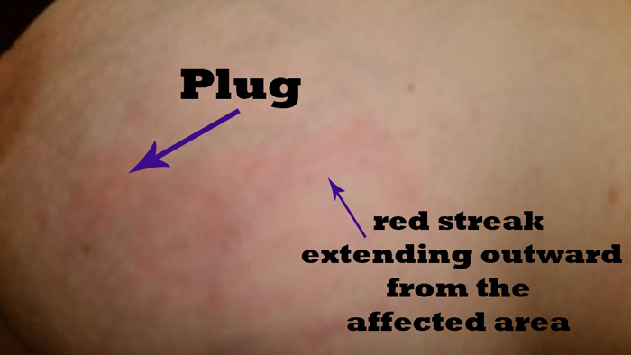
PLUGGED DUCTS
present as a palpable lump or area of the breast that does not soften during a feeding or pumping session.
Causes:
ill-fitting bra, tight, constricting clothing, or a missed or delayed feeding/pumping.
Treatment
Frequent feedings or pumping sessions
moist heat and breast massage before and during feeding
Proper Positioning

Slide 78
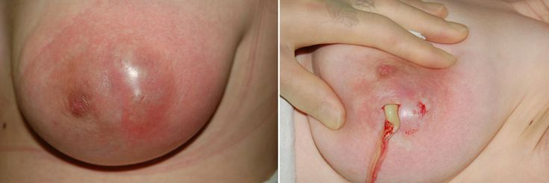
MASTITIS AND BREAST ABSCESS
CAUSES
Engorged breast
Cracked nipple
Clinical features:
High grade fever, raised blood count
Treatment:
Analgesics,Antibiotics
Incision and drainage
Notes:
Mastitis
From Wikipedia, the free encyclopedia
Jump to: navigation, search
MastitisClassification and external resourcesICD-10N61ICD-9611.0DiseasesDB7861MedlinePlus001490MeSHD008413Mastitis is the inflammation of breast tissue.^{[1]} S. aureus is the most common etiological organism responsible, but S. epidermidis and streptococci are occasionally isolated as well.^{[2]}
Mastitis can be classified as milk stasis, non-infectious or infectious inflammation and abscess. It is impossible to correlate this classification with clinical symptoms. In particular, milk stasis, non-infectious and infectious inflammation can be distinguished only by leukocyte count and bacteria culturing. Symptoms like fever, intensity of pain, erythema or rapid onset of symptoms can not be used to distinguish these.
Early stages of mastitis can present with local pain, redness, swelling, and warmth. Later stages also present with systemic symptoms like fever and flu-like symptoms and in rare cases an abscess can develop. However it is pretty common that symptoms develop very quickly without any warning.
Except in severe cases it is not necessary to wean a nursling because of mastitis; in fact, nursing is the most effective way to remove the blockage and alleviate the symptoms. Sudden weaning can cause or exacerbate mastitis symptoms and cause hyponatremic shock in the infant.
Continued breastfeeding does not present any risk to the nursing infant and is very beneficial for the mother.^{[3][4]}
Contents
[hide]
1 Terminology
2 Types
2.1 Puerperal
2.2 Nonpuerperal
3 Symptoms
3.1 Breast abscess
4 Causes
5 Treatment
5.1 Treatment of breast abscess
5.2 Prognosis
6 Risk factors
6.1 Weaning
7 Complications
8 Tests and diagnosis
9 Breast cancer
10 In domestic animals
11 See also
12 References
13 External links
Terminology[edit]
Popular usage of the term mastitis varies by geographic region. Outside the US it is commonly used for puerperal and nonpuerperal cases, in the US the term nonpuerperal mastitis is rarely used and alternative names such as duct ectasia, subareolar abscess and plasma cell mastitis are more frequently used.
Chronic cystic mastitis is a different (older) name for fibrocystic disease.
American usage: mastitis usually refers to puerperal (occurring to breastfeeding mothers) mastitis with symptoms of systemic infection. Lighter cases of puerperal mastitis are often called breast engorgement.
In this Wikipedia article mastitis is used in the original sense of the definition as inflammation of the breast with additional qualifiers where appropriate.
Types[edit]
It is called puerperal mastitis (or lactation mastitis or lactational mastitis) when it occurs in lactating mothers and non-puerperal (or nonlactational) otherwise. Mastitis can, in rare cases, occur in men. Inflammatory breast cancer has symptoms very similar to mastitis and must be ruled out.
The symptoms are similar for puerperal and nonpuerperal mastitis but predisposing factors and treatment can be very different.
Puerperal[edit]
Puerperal mastitis is the inflammation of the breast in connection with pregnancy, breastfeeding or weaning. Since one of the most prominent symptoms is tension and engorgement of the breast, it is thought to be caused by blocked milk ducts or milk excess. It is relatively common; estimates range depending on methodology between 5–33%. However only about 0.4–0.5% of breastfeeding mothers develop an abscess.
Some predisposing factors are known but their predictive value is minimal. It appears that proper breastfeeding technique, frequent breastfeeding and avoidance of stress are the most important factors that can be influenced.
Light cases of mastitis are often called breast engorgement; the distinction is overlapping and possibly arbitrary or subject to regional variations.
Nonpuerperal[edit]
Main article: Nonpuerperal mastitis
The term nonpuerperal mastitis describes inflammatory lesions of the breast occurring unrelated to pregnancy and breastfeeding. This article includes description of mastitis as well as various kinds of mammary abscesses. Skin related conditions like dermatitis and foliculitis are a separate entity.
Names for non-puerperal mastitis are not used very consistently and include mastitis, subareolar abscess, duct ectasia, periductal inflammation, Zuska's disease and others.
Symptoms[edit]
Lactation mastitis usually affects only one breast and the symptoms can develop quickly.^{[5]} The signs and symptoms usually appear suddenly and they include:
Breast tenderness or warmth to the touch
General malaise or feeling ill
Swelling of the breast
Pain or a burning sensation continuously or while breast-feeding
Skin redness, often in a wedge-shaped pattern
Fever of 101 F (38.3 C) or greater^{[6]}
The affected breast can then start to appear lumpy and red.
Some women may also experience flu-like symptoms such as:
Aches
Shivering and chills
Feeling anxious or stressed
Fatigue^{[7]}
Contact should be made with a health care provider with special breastfeeding competence as soon as the patient recognizes the combination of signs and symptoms. Most of the women first experience the flu-like symptoms and just after they may notice a sore red area on the breast. Also, women should seek medical care if they notice any abnormal discharge from the nipples, if breast pain is making it difficult to function each day, or they have prolonged, unexplained breast pain.
Breast abscess[edit]
A breast abscess is a collection of pus that develops into the breast. During lactation, breast abscess develops only rarely, most sources cite about 0.4–0.5%^{[citation needed]} of breastfeeding women. Known risk factors are age over 30, primiparous and late delivery. No correlation was found with smoking status however this may be in part because much fewer smoking women choose to breastfeed^{[citation needed]}. Antibiotics were not shown effective in prevention of lactation abscess but are useful to treat a secondary infection (see section Treatment of breast abscess).
Keratinizing squamous metaplasia of lactiferous ducts may play a similar^{[clarification needed]} role in the pathogenesis of nonpuerperal subareolar abscess.
Causes[edit]
Since the 1980s mastitis has often been divided into non-infectious and infectious sub-groups. However, recent research ^{[8]} suggests that it may not be feasible to make divisions in this way. It has been shown that types and amounts of potentially pathogenic bacteria in breast milk are not correlated to the severity of symptoms. Moreover, although only 15% of women with mastitis in Kvist et al.'s study were given antibiotics, all recovered and few had recurring symptoms. Many healthy breastfeeding women wishing to donate breast milk have potentially pathogenic bacteria in their milk but have no symptoms of mastitis.
Mastitis typically develops when the milk is not properly removed from the breast. Milk stasis can lead to the milk ducts in the breasts becoming blocked, as the breast milk not being properly and regularly expressed.^{[9]} It has also been suggested that blocked milk ducts can occur as a result of pressure on the breast, such as tight-fitting clothing or an over-restrictive bra, although there is sparse evidence for this supposition . Mastitis may occur when the baby is not appropriately attached to the breast while feeding, when the baby has infrequent feeds or has problems suckling the milk out of the breast.
Some women (approximately 15% in Kvist et al. study)^{[8]} will require antibiotic treatment for infection which is usually caused by bacteria from the skin or the baby's mouth that entering the milk ducts through skin lesions of the nipple or through the opening of the nipple.^{[10]} Infection is usually caused by staphylococcus aureus.^{[11]}
Mastitis is quite common among breastfeeding women. The WHO estimates that although incidences vary between 2.6% and 33%, the prevalence globally is approximately 10% of breastfeeding women. Most mothers who develop mastitis usually do so within the first few weeks after delivery. Most breast infections occur within the first or second month after delivery or at the time of weaning.^{[12]} However, in rare cases it affects women who are not breastfeeding.^{[13]}
Infectious pathogens commonly associated with mastitis are Staphylococcus aureus, streptococcus spp., gram-negative bacilli such as Escherichia coli. Salmonella spp., mycobacteria, candida, and Cryptococcus have been identified in rare instances.^{[14]}
Recent research suggests that infectious pathogens play a much smaller role in the pathogenesis than was commonly assumed only a few years ago. Most detected pathogens are very common species that are natural part of the breast fauna and simple detection of their presence is not sufficient to prove a causative role. Furthermore there are indications that treatment with antibiotics may have minimal impact,^{[3][4]} and over-all there is insufficient evidence to confirm or refute the effectiveness of antibiotic therapy for treating lactational mastitis.^{[15]}
The presence of cracks or sores on the nipples increases the likelihood of infection. Tight clothing or ill-fitting bras may also cause problems as they compress the breasts. There is a possibility that infants carrying infectious pathogens in their noses can infect their mothers;^{[16]} the clinical significance of this finding is still unknown.
Mastitis, as well as breast abscess, can also be caused by direct trauma to the breast tissue (breast injury). Such injury can occur for example during sports activities^{[17]} or due to seat belt injury.
Mastitis can also develop due to contamination of a breast implant or any other foreign body, for example after nipple piercing. In such cases, the removal of the foreign body is indicated.^{[18]}
In some rare cases Mastitis can also occur in men.
Treatment[edit]
In lactation mastitis, frequent emptying of both breasts by breastfeeding is essential. Also essential is adequate fluid supply for the mother and baby. Use of pumps to empty the breast is now considered somewhat controversial.^{[citation needed]}
For breastfeeding women with light mastitis, massage and application of heat prior to feeding can help as this may aid unblocking the ducts. However in more severe cases of mastitis heat or massage could make the symptoms worse and cold compresses are better suited to contain the inflammation.
In lactation mastitis, antibiotics are not needed in the overwhelming majority of cases and should be used only for bacterial infections.^{[3]} Dicloxacillin or cephalexin are sometimes recommended,^{[19]} because of the high rates of penicillin resistant staphylococci.
Nonpuerperal mastitis is treated by medication and possibly aspiration or drainage (see in particular treatment of subareolar abscess and treatment of granulomatous mastitis). According to a BMJ best practice report, antibiotics are generally to be used in all nonpuerperal mastitis cases, with replacement of the antibiotics by an antifungal agent such as fluconazole in cases of deep fungal infections, and corticosteroids are to be used in case of granulomatous mastitis (with differential diagnosis to tuberculosis infection of the breast).^{[18]}
Treatment of breast abscess[edit]
An abscess (or suspected abscess) in the breast may be treated by ultrasound-guided fine-needle aspiration (percutaneous aspiration) or by surgical incision and drainage; each of these approaches is performed under antibiotic coverage. In case of puerperal breast abscess, breastfeeding from the affected breast should be continued where possible.^{[3][20]}
For small breast abscesses, ultrasound-guided fine needle aspiration such as to completely drain the abscess is widely recognized as a preferred initial management.^{[21]}
A recent review article suggested the following line of treatment for suspected breast abscess: initially, antibiotics treatment, ultrasound evaluation and, if fluid is present, ultrasound-guided fine needle aspiration of the abscess with an 18 gauge needle, under saline lavage until clear.^{[22]} The exudate is then sent for microbiological analysis for identification of the pathogen and determination of its antibiotic sensitivity profile (antibiogram),^{[23]} which may in turn give an indication for changing the antibiotics prescription. At follow-up, a mammography is performed if the condition has resolved; otherwise the ultrasound-guided fine-needle aspiration with lavage and microbiological analysis is repeated.^{[24]} If three to five aspirations still do not resolve the condition, percutaneous drainage in combination with placement of an indwelling catheter is indicated, and only if several attempts at ultrasound-guided drainage fail, surgical resection of the inflamed lactiferous ducts (preferably performed after the acute episode is over) should be considered.^{[25]} It is noted, however, that even the excision of the affected ducts does not necessarily prevent recurrence.^{[25]}
Nonpuerperal breast abscesses have a higher rate of recurrence compared to puerperal breast abscesses.^{[26]} There is a high statistical correlation of nonpuerperal breast abscess with diabetes mellitus (DM). On this basis, it has recently been suggested that diabetes screening should be performed on patients with such abscess.^{[27][28]}
Prognosis[edit]
Temperature and severity of symptoms at presentation do not predict outcome, women with sore or damaged nipples may need special attention.^{[29][30]}
Risk factors[edit]
Women who are breastfeeding are at risk for developing mastitis especially if they have sore or cracked nipples or have had mastitis before while breastfeeding another baby. Also, the chances of getting mastitis increases if women use only one position to breastfeed or wear a tight-fitting bra, which may restrict milk flow ^{[31]}
Women with diabetes, chronic illness, AIDS, or an impaired immune system may be more susceptible to the development of mastitis.^{[12]}
Weaning[edit]
This section does not cite any references or sources. Please help improve this section by adding citations to reliable sources. Unsourced material may be challenged and removed. (June 2015)Breast engorgement or mastitis occur frequently after weaning. The pregnancy/lactation related hormones usually return to normal levels shortly after weaning but for some women it can take several months and there is an increased risk of rebound lactation and mastitis before hormone levels settle. Avoiding stress is important because the same hormones are also stress hormones. Even after hormone levels settle it takes some time for the breast gland to rebuild to its nonlactating state and it may be particularly prone to mastitis during this time.
Most cases of post weaning mastitis or breast engorgement resolve with relatively little treatment. Recurrent post weaning mastitis on the other hand can be an indication of a developing hyperprolactinemia or thyroid disorders and endocrinological examination must be considered.
Cold compresses, lactation inhibiting herbs or medication can be used.
Salvia officinalis is commonly used for weaning (Veldhuizen-Staas C. 2007),^{[citation needed]} but no peer reviewed literature is known on this subject. Chasteberry extract can improve prolactin levels which may reduce risk of recurrence but no data is available for use in mastitis.
Prolactin lowering medication has been frequently used for weaning in the past but is much less used since Parlodel (bromocriptine) approval for weaning has been withdrawn in the US over safety concerns. While the question of bromocriptin safety for weaning purposes was never completely resolved it became apparent that it was not very effective in the prescribed dose and did rarely justify the unpleasant side effects.
Other prolactin lowering medications (cabergoline, lisuride) are effective and appear safe but are not widely used for weaning.^{[citation needed]}
Granulomatous (non-puerperal) mastitis is known to occur on average 2 years and almost exclusively up to 6 years after pregnancy. It is an extremely rare condition and believed to be in many cases related to an autoimmune reaction to milk proteins following incomplete inhibition of milk secretion and hyperprolactinemia.
Distinction between puerperal (but post-weaning) and nonpuerperal mastitis is somewhat arbitrary.
Complications[edit]
Complications that may arise from mastitis include recurrence, milk stasis and abscess.
Recurrence: women who have had mastitis once are likely to develop it again with a future child or with the same infant. Recurrence appears especially in cases of delayed or inadequate treatment.
Milk stasis: this is another complication that may arise from mastitis and it occurs when the milk is not completely drained from the breast. This causes increased pressure on the ducts and leakage of milk into surrounding breast tissue, which can lead to pain and inflammation.^{[32]}
Abscess: delayed treatment or inadequate treatment, especially in mastitis related to milk stasis, may lead to the formation of an abscess within the breast tissue, that is, a collection of pus that develops into the breast. The abscess is the most severe complication that women can get from this condition. An abscess ultimately requires surgical drainage.
Tests and diagnosis[edit]
The diagnosis of mastitis and breast abscess can usually be made based on a physical examination.^{[11]} The doctor will also take into account the signs and symptoms of the condition.
However, if the doctor is not sure whether the mass is an abscess or a tumor, a breast ultrasound may be performed. The ultrasound provides a clear image of the breast tissue and may be helpful in distinguishing between simple mastitis and abscess or in diagnosing an abscess deep in the breast. The test consists of placing an ultrasound probe over the breast.
In cases of infectious mastitis, cultures may be needed in order to determine what type of organism is causing the infection. Cultures are helpful in deciding the specific type of antibiotics that will be used in curing the disease. These cultures may be taken either from the breast milk or of the material aspirated from an abscess.
Mammograms or breast biopsies are normally performed on women who do not respond to treatment or on non-breastfeeding women. This type of tests is sometimes ordered to exclude the possibility of a rare type of breast cancer which causes symptoms similar to those of mastitis.
Breast cancer[edit]
Breast cancer may coincide with or mimic symptoms of mastitis. Only full resolution of symptoms and careful examination are sufficient to exclude the diagnosis of breast cancer.
Lifetime risk for breast cancer is significantly reduced for women who were pregnant and breastfeeding. Mastitis episodes do not appear to influence lifetime risk of breast cancer.
Mastitis does however cause great difficulties in diagnosis of breast cancer and delayed diagnosis and treatment can result in worse outcome.
Breast cancer may coincide with mastitis or develop shortly afterwards. All suspicious symptoms that do not completely disappear within 5 weeks must be investigated.
Breast cancer incidence during pregnancy and lactation is assumed to be the same as in controls. Course and prognosis are also very similar to age matched controls.^{[33][34]} However diagnosis during lactation is particularly problematic, often leading to delayed diagnosis and treatment.
Some data suggest that noninflammatory breast cancer incidence is increased within a year following episodes of nonpuerperal mastitis and special care is required for follow-up cancer prevention screening.^{[35]} So far only data from short term observation is available and total risk increase can not be judged. Because of the very short time between presentation of mastitis and breast cancer in this study it is considered very unlikely that the inflammation had any substantial role in carcinogenesis, rather it would appear that some precancerous lesions may increase the risk of inflammation (hyperplasia causing duct obstruction, hypersensitivity to cytokines or hormones) or the lesions may have common predisposing factors.
A very serious type of breast cancer called inflammatory breast cancer presents with similar symptoms as mastitis (both puerperal and nonpuerperal). It is the most aggressive type of breast cancer with the highest mortality rate. The inflammatory phenotype of IBC is thought to be mostly caused by invasion and blocking of dermal lymphatics, however it was recently shown that NF-κB target genes activation may significantly contribute to the inflammatory phenotype. Case reports show that inflammatory breast cancer symptoms can flare up following injury or inflammation making it even more likely to be mistaken for mastitis. Symptoms are also known to partially respond to progesterone and antibiotics, reaction to other common medications can not be ruled out at this point.^{[36][37][38][39][40]}
In domestic animals[edit]
Udder of a Roux du Valais sheep after a healed mastitis, one teat was lost due to the disease.
Serous exudate from bovine udder in E. coli mastitis^{[41]} at left. Normal milk at right.
See also: Mastitis in dairy cattle
Mastitis occurs in domestic animals as in human beings, and is especially a concern in livestock, since milk from the affected udders of livestock may enter the food supply and pose a health risk.
It is a major condition in some species, like dairy cows. This is the cause of very much unwanted suffering for the dairy cows. It is of tremendous economic importance for the dairy industry, and it is also of concern for public health. The same considerations apply to mastitis in sheep and goats and other milk producing females. It is also of economic importance in the sow, but, in this species, it is not related to public health. In other domestic females (queen, mare, etc.), it is more an individual illness dealt with by veterinary practitioners.
See also[edit]

Slide 79
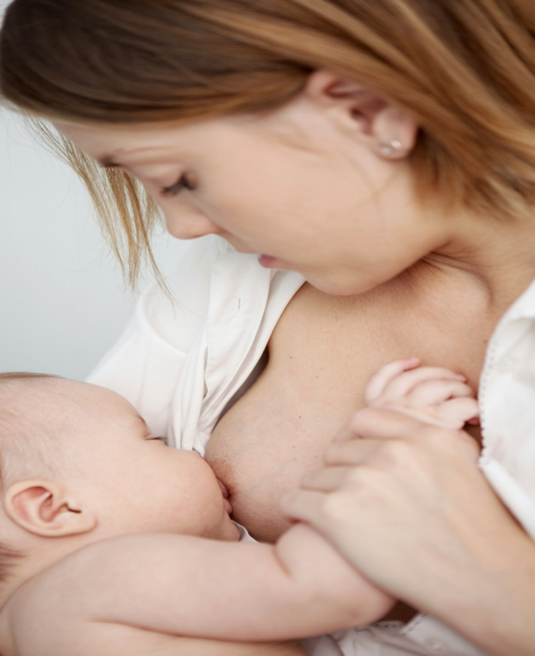
INADEQUATE MILK INTAKE
Causes
Incorrect method of breastfeeding
Insufficient milk production
Any illness
Painful condition
Maternal stress and insufficient sleep
Advice to mother
Sufficient rest
Adequate fluids intake
Feed baby on demand
Notes:
Insufficient milk intake, dehydration, and jaundice in the infant can become evident within the first week of life. Signs of insufficient milk intake include: lethargy, delayed stooling, decreased urine output, weight loss >7% of birth weight, hypernatremic dehydration, inconsolable crying and increased hunger. Insufficient milk intake may be caused by insufficient milk production, failure of established breastfeeding, and health conditions in the infant that prevent proper breast stimulation. Parents should be counseled that breastfed neonates feed 8-12 times a day with a minimum of 8 times per day. Careful attention to prenatal history can identify maternal factors that may be associated with this problem (failure of breasts to enlarge during pregnancy or within the first few days after delivery). Direct observation of breastfeeding can help identify improper technique. If a large volume of milk is expressed manually after breastfeeding, then the infant might not be extracting enough milk, eventually leading to decreased milk output. Late preterm infants (34-36 wk) are at risk for insufficient milk syndrome because of poor suck and swallow patterns or medical issues.
Jaundice Breastfeeding jaundice is a common reason for hospital readmis

Slide 80
BREASTFEEDING JAUNDICE
occur in the first week of life in more than 1 in 10 breastfed infants.
inadequate milk intake, leading to dehydration or low caloric intake.
type of physiologic or exaggerated physiologic jaundice.
Notes:
. Breast-milk jaundice is of late onset and has an incidence in term infants of 2% to 4%. By day 4, instead of the usual fall in the serum bilirubin level, the bilirubin level continues to rise and may reach 20 to 30 mg/dL by 14 days of age. If breast-feeding is continued, the levels will stay elevated and then fall slowly at 2 weeks of age, returning to normal by 4 to 12 weeks of age. If breast-feeding is stopped, the bilirubin level will fall rapidly in 48 hours. If nursing is then resumed, the bilirubin may rise 2 to 4 mg/dL but usually will not reach the previous high level. These infants show good weight gain, have normal liver function test (LFT) results, and show no evidence of hemolysis. Mothers with infants who have breast-milk jaundice syndrome have a recurrence rate of 70% in future pregnancies (see I.B.3 for potential genetic influences). The mechanism of true breast-milk jaundice is unknown but is thought to be due to an unidentified factor (or factors) in breast milk interfering with bilirubin metabolism. Additionally, compared with formula-fed infants, breast-fed infants are more likely to have increased enterohepatic circulation because they ingest the β-glucuronidase present in breast milk, are slower to be colonized with intestinal bacteria that convert CB to urobilinoids, and excrete less stool. There are reports of kernicterus in otherwise healthy, breast-fed, term newborns.
b. Breast-feeding jaundice. Infants who are breast-fed have higher bilirubin levels after day 3 of life compared to formula-fed infants. The differences in the levels of bilirubin are usually not clinically significant. The incidence of peak bilirubin levels >12 mg/dL in breast-fed term infants is 12% to 13%. The main factor thought to be responsible for breast-feeding jaundice is a decreased intake of milk that leads to increased enterohepatic circulation.

Slide 81
BREAST MILK JAUNDICE
1 in 200 babies.
visible after > 1 week
Declines in the 2nd or 3rd week.
caused by substances in mother milk that decrease the infant's liver's ability to deal with bilirubin.
Breast milk jaundice rarely causes It is usually not a reason to stop nursing.
Notes:
Breastfeeding jaundice is a common reason for hospital readmission of healthy breastfed infanintake during the first week of life (see Chapter 102.3). It may also be associated with dehydration and hypernatremia. Breast milk jaundice is a different disorder that causes persistently high serum indirect bilirubin in a thriving healthy baby that becomes evident later than breastfeeding jaundice, but which generally declines in the 2nd to 3rd wk of life. Infants with severe or persistent jaundice should be evaluated for other medical causes (see Chapter 102.3) before ascribing the jaundice to breast milk that might contain inhibitors of glucuronyl transferase or enhanced absorption of bilirubin from the gut. Persistently high bilirubin levels may require changing from breast milk to infant formula for 24-48 hr and/or treatment with phototherapy without cessation of breastfeeding. Breastfeeding should resume after the decline in serum bilirubin. Parents should be reassured and encouraged to continue collecting breast milk during the period when the infant is taking formula.ts and is largely related to insufficient fluid

Slide 82
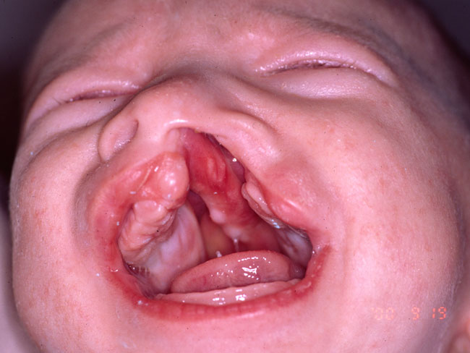
SPECIAL SITUATIONS
1. Congenital anomalies may require special management.
a. Craniofacial anomalies (i.e., cleft lip/palate, Pierre-Robin)
Treatment
Modified positioning
special devices (i.e., obturator, nipple shield) may be utilized to achieve an effective latch..
Notes:
Abstract
A central goal of the Academy of Breastfeeding Medicine is the development of clinical protocols for managing common medical problems that may impact breastfeeding success. These protocols serve only as guidelines for the care of breastfeeding mothers and infants and do not delineate an exclusive course of treatment or serve as standards of medical care. Variations in treatment may be appropriate according to the needs of an individual patient.
Go to:
Definitions
When a cleft lip (CL) occurs, the lip is not contiguous, and when a cleft palate (CP) occurs, there is communication between the oral and nasal cavities.¹ Clefts can range in severity from a simple notch in the upper lip to a complete opening in the lip extending into the floor of the nasal cavity and involving the alveolus to the incisive foramen.² Similarly, CP may involve just the soft palate or extend partially or completely through the hard and soft palates.¹ In CP, the alveolus remains intact. A CP may be submucous and not immediately detected if there are subtle or no corresponding clinical signs or symptoms.¹
Go to:
Background
Incidence
The worldwide prevalence of CL and/or CP (CL/P) ranges from 0.8 to 2.7 cases per 1,000 live births.³ There are differences in incidence rates across racial groups, with the lowest reported incidence among African-American populations (approximately 0.5 per 1,000)^{4,5} and white populations (approximately one per 1,000 births)³ and higher incidence among Native American (approximately 3.5 per 1,000)⁶ and Asian (approximately 1.7 per 1,000)⁷ populations.
Although reports vary considerably, it is estimated that out of the total number of infants with CL/P, approximately 50% have combined cleft lip and palate (CLP), whereas 30% have isolated CP, and 20% have isolated CL; CL extending to include the alveolus occurs in approximately 5% of cases.⁸ Clefts are usually unilateral (Fig. 1); however, in approximately 10% of cases, clefts are bilateral.⁹
FIG. 1.
Unilateral cleft lip. Photo courtesy of John A. Girotto, MD.
Breastfeeding and CL/P
In these guidelines, breastfeeding refers to direct placement of baby to the breast for feeding, and breastmilk feeding refers to delivery of breastmilk to baby via bottle, cup, spoon, or any other means except breast. Babies use both suction and compression to breastfeed successfully. The ability to generate suction is necessary for attachment to the breast, maintenance of a stable feeding position, and, together with the let-down reflex, milk extraction. Normally, when a baby is feeding, his or her lips flange firmly against the areola, sealing the oral cavity anteriorly. The soft palate rises up and back to contact the pharyngeal walls and seal the oral cavity posteriorly. As the tongue and jaw drop during sucking, the oral cavity increases in size, and suction is generated, drawing milk from the breast.¹⁰ Compression occurs when the baby presses the breast between the tongue and jaw. Suction and compression help milk transfer delivery during breastfeeding.^{10–12}
There is a relationship between the amount of oral pressure generated during feeding and the size/type of cleft and maturity of the baby.¹³ For this reason, babies with CL are more likely to breastfeed than those with CP and CLP.¹⁴ Some babies with small clefts of the soft palate generate suction,¹⁵ but others with larger clefts of the soft and/or hard palate may not generate suction.^{15,16} Newborns and premature babies generate lower suction pressures compared with older babies.^{13,17,18} Babies with CP or CLP have difficulty creating suction¹⁹ because the oral cavity cannot be adequately separated from the nasal cavity during feeding. For these infants, negative consequences may include fatigue during breastfeeding, prolonged feeding times, and impaired growth and nutrition.
The literature describing breastfeeding outcomes is limited, and the evidence is anecdotal and contradictory, making the recommendations that follow challenging.²⁰
Go to:
Recommendations
Quality of evidence (levels of evidence I, II-1, II-2, II-3, and III) for each recommendation, as defined in the U.S. Preventive Services Task Force Appendix A Task Force Ratings,²¹ is noted in parentheses.
Summary of recommendations for clinical practice
Based on the reviewed evidence, the following recommendations are made:
1. Mothers should be encouraged to provide the protective benefits of breastmilk. Evidence suggests that breastfeeding protects against otitis media, which is highly prevalent in this population.^{22,23} (II-2) Breastmilk feeding (via cup, spoon, bottle, etc.) should be promoted in preference to artificial milk feeding. Additionally, there is speculative information regarding possible benefits of breastfeeding versus bottle feeding on the development of the oral cavity.
2. At the same time, mothers should be counseled about likely breastfeeding success. Where direct breastfeeding is unlikely to be the sole feeding method, the need for breastmilk feeding should be encouraged, and, when appropriate, possible delayed transitioning to breastfeeding should be discussed.
3. Babies with CL/P should be evaluated for breastfeeding on an individual basis. In particular, it is important to take into account the size and location of the baby's CL/P as well as the mother's wishes and previous experience with breastfeeding. There is moderate evidence to suggest that infants with CL are able to generate suction¹⁹ (III), and descriptive reports suggest that these infants are often able to breastfeed successfully.²⁴ (III) There is moderate evidence that infants with CP or CLP have difficulty generating suction¹⁵ (I) and have inefficient sucking patterns¹⁶ (I) compared with normal infants. The success rates for breastfeeding infants with CP or CLP are observed to be lower than for infants with CL or no cleft.^{14,24} (III) (Appendix)
4. As in normal breastfeeding, knowledgeable support is important. Mothers who wish to breastfeed should be given immediate access to a lactation specialist to assist with positioning, management of milk supply, and expressing milk for supplemental feeds. Several studies have suggested that there is a need for and benefit from having access to a health professional who specializes in CL/P, such as a clinical nurse specialist, during the newborn/infant periods for specialized advice on feeding a baby with CL/P as well as referrals to appropriate services.²⁵ Surveys of parents with a child with CL, CLP, or CP indicated a desire for more instruction on feeding challenges as early as possible.²⁶ (III)
5. Families may benefit from peer support around breastmilk feeding or breastfeeding found through associations like Wild Smile²⁷ in addition to routine referral to breastfeeding support groups.
6. Monitoring of a baby's hydration and weight gain is important while a feeding method is being established. If inadequate, supplemental feeding should be implemented or increased. (See “ABM clinical protocol #3: Hospital guidelines for the use of supplementary feedings in the healthy term breastfed neonate, revised 2009.”²⁸) Infants with CL/P may require supplemental feeds for adequate growth and nutrition.²⁴ (III) There is one study that demonstrated that additional maternal support by a clinical nurse specialist can both improve weight gain outcomes and also facilitate referral to appropriate services.²⁹ (III)
7. Modification to breastfeeding positions may increase the efficiency and effectiveness of breastfeeding. Positioning recommendations that have been recommended on the basis of weak evidence (clinical experience or expert opinion) and should be evaluated for success are:
a. For infants with CL:
i. The infant should be held so that the CL is oriented toward the top of the breast^{30,31} (for example, an infant with a [right] CL may feed more efficiently in a cross-cradle position at the right breast and a “football/twin style” position at the left breast). (III)
ii. The mother may occlude the CL with her thumb or finger^{31,32} and/or support the infant's cheeks to decrease the width of the cleft and increase closure around the nipple.³³ (III)
iii. For bilateral CL, a “face on” straddle position may be more effective than other breastfeeding positions.³¹ (III)
b. For infants with CP or CLP:
i. Positioning should be semi-upright to reduce nasal regurgitation and reflux of breastmilk into the Eustachian tubes.^{31,32,34–36} (III)
ii. A “football hold”/twin position (the body of the infant positioned alongside the mother, rather than across the mother's lap, and with the infant's shoulders higher than his or her body) may be more effective than a cross-cradle position.³⁶ (III)
iii. For infants with CP it may also be useful to position the breast toward the “greater segment”—the side of the palate that has the most intact bone. This may facilitate better compression and stop the nipple being pushed into the cleft site.³⁷ (III)
iv. Some experts suggest supporting the infant's chin to stabilize the jaw during sucking³² and/or supporting the breast so that it remains in the infant's mouth.^{33,38} (III)
v. If the cleft is large, some experts suggest that the breast be tipped downward to stop the nipple being pushed into the cleft.³⁰ (III)
vi. Mothers may need to manually express breastmilk into the baby's mouth to compensate for absent suction and compression and to stimulate the let-down reflex.³⁸ (III)
8. If a prosthesis is used for orthopedic alignment prior to surgery, caution should be used in advising parents to use such devices to facilitate breastfeeding, as there is strong evidence that they do not significantly increase feeding efficiency or effectiveness.^{39,40} (III)
9. Evidence suggests that breastfeeding can commence/recommence immediately following CL repair and that breastfeeding may be slightly more advantageous than spoon feeding.^{41,42} (I) Breastfeeding can commence/recommence 1 day after CP repair without complication to the wound.⁴¹ In a survey of CP surgeons regarding postoperative care after palatoplasty, two-thirds of surgeons allowed mothers to breastfeed immediately after surgery.⁴³ (III)
10. Assessment of the potential for breastfeeding of infants with CL/P as part of a syndrome/sequence should be made on a case-by-case basis, taking into account the additional features of the syndrome that may impact on breastfeeding success.
Recommendations for future research
The most pressing issue for healthcare professionals working with mothers who wish to breastfeed their infants with CL/P is the lack of evidence on which to base clinical decisions. Well-designed, data-driven investigations that document feeding success rates, management strategies, and outcomes for infants with CL/P are imperative. Furthermore, investigators must clearly describe their sample of infants and intervention techniques so that the research outcomes are able to be generalized.

Slide 83
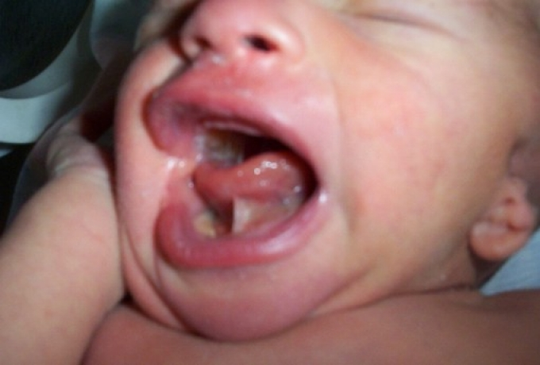
SPECIAL SITUATIONS
b. Cardiac disease/defects may require fluid restriction status of the infant and special attention to pacing of feeds to minimize fatigue during feeding.
c. Ankyloglossia (tongue tie)
Frenulotomy is often the treatment of choice
Notes:
Cleft lip and palate
From Wikipedia, the free encyclopedia
(Redirected from Cleft palate)
Jump to: navigation, search
Cleft lip and palate Child with cleft lip and palate.
Classification and external resourcesICD-10Q35-Q37ICD-9749MedlinePlus001051eMedicineped/2679Cleft lip and cleft palate, also known as orofacial cleft and cleft lip and palate, is a group of conditions that includes cleft lip (CL), cleft palate (CP), and both together.^{[1][2]} A cleft lip contains an opening in the upper lip that may extend into the nose. The opening may be on one side, both sides, or in the middle. A cleft palate is when the roof of the mouth contains an opening into the nose. These disorders can result in feeding problems, speech problems, hearing problems, and frequent ear infections. Less than half the time the condition is associated with other disorders.^{[1]}
Cleft lip and palate is due tissues of the face not properly joining together during development. They are a type of birth defect. The cause in most cases is unknown.^{[1]} Risk factors include smoking during pregnancy, diabetes, an older mother, obesity, and certain medications such as some used to treat seizures.^{[1][2]} They can often be diagnosed during an ultrasound done during pregnancy.^{[1]}
A cleft lip or palate can be successfully treated with surgery. This is often done in the first few months of life for cleft lip and before eighteen months for cleft palate. Speech therapy and dental care may also be needed. With appropriate treatment outcomes are good.^{[1]}
Cleft lip and palate occurs in about 1 to 2 per 1000 births in the developed world.^{[2]} CL is about twice as common in males as females, while CP without CL is more common in females.^{[2]} In 2013 it resulted in about 3,300 deaths globally down from 7,600 deaths in 1990.^{[3]} The condition was previously known as a hare-lip due to similarity to a rabbit, but that term is now generally considered to be offensive.^{[4]}
Contents
[hide]
1 Signs and symptoms
1.1 Cleft palate
1.2 Psychosocial
1.3 Complications
2 Cause
2.1 Genetics
2.1.1 Syndromes
2.1.2 Specific genes
2.2 Environment
3 Diagnosis
4 Treatment
4.1 Cleft lip
4.1.1 Pre-surgical devices
4.2 Cleft palate
4.3 Speech and hearing
4.4 Hearing loss
4.5 Sample treatment schedule
4.6 Craniofacial team
5 Epidemiology
6 Society and culture
6.1 Names
6.2 Controversy
6.3 Notable cases
6.4 Works of fiction
7 Other animals
8 See also
9 References
10 Further reading
11 External links
Signs and symptoms
If the cleft does not affect the palate structure of the mouth it is referred to as cleft lip. Cleft lip is formed in the top of the lip as either a small gap or an indentation in the lip (partial or incomplete cleft) or it continues into the nose (complete cleft). Lip cleft can occur as a one sided (unilateral) or two sided (bilateral). It is due to the failure of fusion of the maxillary and medial nasal processes (formation of the primary palate).
Unilateral incomplete
Unilateral complete
Bilateral complete
A mild form of a cleft lip is a microform cleft.^{[5]} A microform cleft can appear as small as a little dent in the red part of the lip or look like a scar from the lip up to the nostril.^{[6]} In some cases muscle tissue in the lip underneath the scar is affected and might require reconstructive surgery.^{[7]} It is advised to have newborn infants with a microform cleft checked with a craniofacial team as soon as possible to determine the severity of the cleft.^{[8]}
Six-month-old girl before going into surgery to have her unilateral complete cleft lip repaired
The same girl, 1 month after the surgery
The same girl, age 8, the scar almost gone
Cleft palate
Cleft palate is a condition in which the two plates of the skull that form the hard palate (roof of the mouth) are not completely joined. The soft palate is in these cases cleft as well. In most cases, cleft lip is also present. Cleft palate occurs in about one in 700 live births worldwide.^{[9]}
Palate cleft can occur as complete (soft and hard palate, possibly including a gap in the jaw) or incomplete (a 'hole' in the roof of the mouth, usually as a cleft soft palate). When cleft palate occurs, the uvula is usually split. It occurs due to the failure of fusion of the lateral palatine processes, the nasal septum, and/or the median palatine processes (formation of the secondary palate).
The hole in the roof of the mouth caused by a cleft connects the mouth directly to the inside of the nose.
Note: the next images show the roof of the mouth. The top shows the nose, the lips are colored pink. For clarity the images depict a toothless infant.
Incomplete cleft palate
Unilateral complete lip and palate
Bilateral complete lip and palate
A result of an open connection between the mouth and inside the nose is called velopharyngeal inadequacy (VPI). Because of the gap, air leaks into the nasal cavity resulting in a hypernasal voice resonance and nasal emissions while talking.^{[10]} Secondary effects of VPI include speech articulation errors (e.g., distortions, substitutions, and omissions) and compensatory misarticulations and mispronunciations (e.g., glottal stops and posterior nasal fricatives).^{[11]} Possible treatment options include speech therapy, prosthetics, augmentation of the posterior pharyngeal wall, lengthening of the palate, and surgical procedures.^{[10]}
Submucous cleft palate (SMCP) can also occur, which is a cleft of the soft palate with a classic clinical triad of a bifid, or split, uvula which is found dangling in the back of the throat, a furrow along the midline of the soft palate, and a notch in the back margin of the hard palate.^{[12]}
Psychosocial
Most children who have their clefts repaired early enough are able to have a happy youth and social life.^{[citation needed]} Having a cleft palate/lip does not inevitably lead to a psychosocial problem.^{[citation needed]} However, adolescents with cleft palate/lip are at an elevated risk for developing psychosocial problems especially those relating to self-concept, peer relationships and appearance. Adolescents may face psychosocial challenges but can find professional help if problems arise.^{[citation needed]} A cleft palate/lip may impact an individual’s self-esteem, social skills and behavior. There is research dedicated to the psychosocial development of individuals with cleft palate. Self-concept may be adversely affected by the presence of a cleft lip and/or cleft palate, particularly among girls.^{[13]}
Research has shown that during the early preschool years (ages 3–5), children with cleft lip and/or cleft palate tend to have a self-concept that is similar to their peers without a cleft. However, as they grow older and their social interactions increase, children with clefts tend to report more dissatisfaction with peer relationships and higher levels of social anxiety. Experts conclude that this is probably due to the associated stigma of visible deformities and possible speech impediments. Children who are judged as attractive tend to be perceived as more intelligent, exhibit more positive social behaviors, and are treated more positively than children with cleft lip and/or cleft palate.^{[14]} Children with clefts tend to report feelings of anger, sadness, fear, and alienation from their peers, but these children were similar to their peers in regard to "how well they liked themselves."
The relationship between parental attitudes and a child’s self-concept is crucial during the preschool years. It has been reported that elevated stress levels in mothers correlated with reduced social skills in their children.^{[15]} Strong parent support networks may help to prevent the development of negative self-concept in children with cleft palate.^{[16]} In the later preschool and early elementary years, the development of social skills is no longer only impacted by parental attitudes but is beginning to be shaped by their peers. A cleft lip and/or cleft palate may affect the behavior of preschoolers. Experts suggest that parents discuss with their children ways to handle negative social situations related to their cleft lip and/or cleft palate. A child who is entering school should learn the proper (and age-appropriate) terms related to the cleft. The ability to confidently explain the condition to others may limit feelings of awkwardness and embarrassment and reduce negative social experiences.^{[17]}
As children reach adolescence, the period of time between age 13 and 19, the dynamics of the parent-child relationship change as peer groups are now the focus of attention. An adolescent with cleft lip and/or cleft palate will deal with the typical challenges faced by most of their peers including issues related to self-esteem, dating and social acceptance.^{[18][19][20]} Adolescents, however, view appearance as the most important characteristic above intelligence and humor.^{[21]} This being the case, adolescents are susceptible to additional problems because they cannot hide their facial differences from their peers. Adolescent boys typically deal with issues relating to withdrawal, attention, thought, and internalizing problems and may possibly develop anxiousness-depression and aggressive behaviors.^{[20]} Adolescent girls are more likely to develop problems relating to self-concept and appearance. Individuals with cleft lip and/or cleft palate often deal with threats to their quality of life for multiple reasons including: unsuccessful social relationships, deviance in social appearance and multiple surgeries.
Complications
A baby being fed using a customized bottle. The upright sitting position allows gravity to help the baby swallow the milk more easily
Cleft may cause problems with feeding, ear disease, speech and socialization.
Due to lack of suction, an infant with a cleft may have trouble feeding. An infant with a cleft palate will have greater success feeding in a more upright position. Gravity will help prevent milk from coming through the baby's nose if he/she has cleft palate. Gravity feeding can be accomplished by using specialized equipment, such as the Haberman Feeder, or by using a combination of nipples and bottle inserts like the one shown, is commonly used with other infants. A large hole, crosscut, or slit in the nipple, a protruding nipple and rhythmically squeezing the bottle insert can result in controllable flow to the infant without the stigma caused by specialized equipment.
Individuals with cleft also face many middle ear infections which may eventually lead to hearing loss. The Eustachian tubes and external ear canals may be angled or tortuous, leading to food or other contamination of a part of the body that is normally self-cleaning. Hearing is related to learning to speak. Babies with palatal clefts may have compromised hearing and therefore, if the baby cannot hear, it cannot try to mimic the sounds of speech. Thus, even before expressive language acquisition, the baby with the cleft palate is at risk for receptive language acquisition. Because the lips and palate are both used in pronunciation, individuals with cleft usually need the aid of a speech therapist.
Cause
The development of the face is coordinated by complex morphogenetic events and rapid proliferative expansion, and is thus highly susceptible to environmental and genetic factors, rationalising the high incidence of facial malformations. During the first six to eight weeks of pregnancy, the shape of the embryo's head is formed. Five primitive tissue lobes grow:
a) one from the top of the head down towards the future upper lip; (Frontonasal Prominence)b-c) two from the cheeks, which meet the first lobe to form the upper lip; (Maxillar Prominence)d-e) and just below, two additional lobes grow from each side, which form the chin and lower lip; (Mandibular Prominence)If these tissues fail to meet, a gap appears where the tissues should have joined (fused). This may happen in any single joining site, or simultaneously in several or all of them. The resulting birth defect reflects the locations and severity of individual fusion failures (e.g., from a small lip or palate fissure up to a completely malformed face).
The upper lip is formed earlier than the palate, from the first three lobes named a to c above. Formation of the palate is the last step in joining the five embryonic facial lobes, and involves the back portions of the lobes b and c. These back portions are called palatal shelves, which grow towards each other until they fuse in the middle.^{[22]} This process is very vulnerable to multiple toxic substances, environmental pollutants, and nutritional imbalance. The biologic mechanisms of mutual recognition of the two cabinets, and the way they are glued together, are quite complex and obscure despite intensive scientific research.^{[23]}
Genetics
Genetic factors contributing to cleft lip and cleft palate formation have been identified for some syndromic cases, but knowledge about genetic factors that contribute to the more common isolated cases of cleft lip/palate is still patchy.
Many clefts run in families, even though in some cases there does not seem to be an identifiable syndrome present,^{[24]} possibly because of the current incomplete genetic understanding of midfacial development.
A number of genes are involved including cleft lip and palate transmembrane protein 1 and GAD1,^{[25]} one of the glutamate decarboxylases. Many genes are known to play a role in craniofacial development and are being studied through the FaceBase initiative for their part in clefting. These genes are AXIN2, BMP4, FGFR1, FGFR2, FOXE1, IRF6, MAFB (gene), MMP3, MSX1, MSX2 (Msh homeobox 2), MSX3, PAX7, PDGFC, PTCH1, SATB2, SOX9, SUMO1 (Small ubiquitin-related modifier 1), TBX22, TCOF (Treacle protein), TFAP2A, VAX1, TP63, ARHGAP29, NOG, NTN1, WNT genes, and locus 8q24.^{[26]}
Syndromes
The Van der Woude Syndrome is caused by a specific variation in the gene IRF6 that increases the occurrence of these deformities threefold.^{[27][28][29]}
Another syndrome, Siderius X-linked mental retardation, is caused by mutations in the PHF8 gene (OMIM 300263); in addition to cleft lip and/or palate, symptoms include facial dysmorphism and mild mental retardation.^{[30]}
In some cases, cleft palate is caused by syndromes which also cause other problems.
Stickler's Syndrome can cause cleft lip and palate, joint pain, and myopia.^{[31][32]}
Loeys-Dietz syndrome can cause cleft palate or bifid uvula, hypertelorism, and aortic aneurysm.^{[33]}
Hardikar syndrome can cause cleft lip and palate, Hydronephrosis, Intestinal obstruction and other symptoms.^{[34]}
Cleft lip/palate may be present in many different chromosome disorders including Patau Syndrome (trisomy 13).
Malpuech facial clefting syndrome
Hearing loss with craniofacial syndromes
Popliteal pterygium syndrome
Treacher Collins Syndrome
Specific genes
TypeOMIMGeneLocusOFC1119530 ?6p24OFC2602966 ?2p13OFC3600757 ?19q13OFC4608371 ?4qOFC5608874MSX14p16.1OFC6608864 ?1qOFC7600644)PVRL111qOFC8129400TP633q27OFC9610361 ?13q33.1-q34OFC10601912SUMO12q32.2-q33OFC11600625BMP414q22OFC12612858 ?8q24.3Many genes associated with syndromic cases of cleft lip/palate (see above) have been identified to contribute to the incidence of isolated cases of cleft lip/palate. This includes in particular sequence variants in the genes IRF6, PVRL1 and MSX1.^{[35]} The understanding of the genetic complexities involved in the morphogenesis of the midface, including molecular and cellular processes, has been greatly aided by research on animal models, including of the genes BMP4, SHH, SHOX2, FGF10 and MSX1.^{[35]}
Environment
Environmental influences may also cause, or interact with genetics to produce, orofacial clefting. An example for how environmental factors might be linked to genetics comes from research on mutations in the gene PHF8 that cause cleft lip/palate (see above). It was found that PHF8 encodes for a histone lysine demethylase,^{[36]} and is involved in epigenetic regulation. The catalytic activity of PHF8 depends on molecular oxygen,^{[36]} a fact considered important with respect to reports on increased incidence of cleft lip/palate in mice that have been exposed to hypoxia early during pregnancy.^{[37]} In humans, fetal cleft lip and other congenital abnormalities have also been linked to maternal hypoxia, as caused by e.g. maternal smoking,^{[38]} maternal alcohol abuse or some forms of maternal hypertension treatment.^{[39]} Other environmental factors that have been studied include: seasonal causes (such as pesticide exposure); maternal diet and vitamin intake; retinoids — which are members of the vitamin A family; anticonvulsant drugs; alcohol; cigarette use; nitrate compounds; organic solvents; parental exposure to lead; and illegal drugs (cocaine, crack cocaine, heroin, etc.).
Current research continues to investigate the extent to which folic acid can reduce the incidence of clefting.^{[40]}
Diagnosis
Traditionally, the diagnosis is made at the time of birth by physical examination. Recent advances in prenatal diagnosis have allowed obstetricians to diagnose facial clefts in utero.^{[41]}
Clefts can also affect other parts of the face, such as the eyes, ears, nose, cheeks, and forehead. In 1976, Paul Tessier described fifteen lines of cleft. Most of these craniofacial clefts are even rarer and are frequently described as Tessier clefts using the numerical locator devised by Tessier.^{[42]}
Treatment
Cleft lip and palate is very treatable; however, the kind of treatment depends on the type and severity of the cleft.
Most children with a form of clefting are monitored by a cleft palate team or craniofacial team through young adulthood.^{[43]} Care can be lifelong. Treatment procedures can vary between craniofacial teams. For example, some teams wait on jaw correction until the child is aged 10 to 12 (argument: growth is less influential as deciduous teeth are replaced by permanent teeth, thus saving the child from repeated corrective surgeries), while other teams correct the jaw earlier (argument: less speech therapy is needed than at a later age when speech therapy becomes harder). Within teams, treatment can differ between individual cases depending on the type and severity of the cleft.
Cleft lip
Within the first 2–3 months after birth, surgery is performed to close the cleft lip. While surgery to repair a cleft lip can be performed soon after birth, often the preferred age is at approximately 10 weeks of age, following the "rule of 10s" coined by surgeons Wilhelmmesen and Musgrave in 1969 (the child is at least 10 weeks of age; weighs at least 10 pounds, and has at least 10g hemoglobin).^{[44]} If the cleft is bilateral and extensive, two surgeries may be required to close the cleft, one side first, and the second side a few weeks later. The most common procedure to repair a cleft lip is the Millard procedure pioneered by Ralph Millard. Millard performed the first procedure at a Mobile Army Surgical Hospital (MASH) unit in Korea.^{[45]}
Often an incomplete cleft lip requires the same surgery as complete cleft. This is done for two reasons. Firstly the group of muscles required to purse the lips run through the upper lip. In order to restore the complete group a full incision must be made. Secondly, to create a less obvious scar the surgeon tries to line up the scar with the natural lines in the upper lip (such as the edges of the philtrum) and tuck away stitches as far up the nose as possible. Incomplete cleft gives the surgeon more tissue to work with, creating a more supple and natural-looking upper lip.
The blue lines indicate incisions.
Movement of the flaps; flap A is moved between B and C. C is rotated slightly while B is pushed down.
Pre-operation
Post-operation, the lip is swollen from surgery and will get a more natural look within a couple of weeks. See photos in the section above.
Pre-surgical devices
In some cases of a severe bi-lateral complete cleft, the premaxillary segment will be protruded far outside the mouth.
Nasoalveolar molding prior to surgery can improve long-term nasal symmetry among patients with complete unilateral cleft lip-cleft palate patients compared to correction by surgery alone, according to a retrospective cohort study.^{[46]} In this study, significant improvements in nasal symmetry were observed in multiple areas including measurements of the projected length of the nasal ala (lateral surface of the external nose), position of the superoinferior alar groove, position of the mediolateral nasal dome, and nasal bridge deviation. "The nasal ala projection length demonstrated an average ratio of 93.0 percent in the surgery-alone group and 96.5 percent in the nasoalveolar molding group" this study concluded.
Cleft palate
A repaired cleft palate on a 64-year-old female.
Often a cleft palate is temporarily covered by a palatal obturator (a prosthetic device made to fit the roof of the mouth covering the gap).
Cleft palate can also be corrected by surgery, usually performed between 6 and 12 months. Approximately 20–25% only require one palatal surgery to achieve a competent velopharyngeal valve capable of producing normal, non-hypernasal speech. However, combinations of surgical methods and repeated surgeries are often necessary as the child grows. One of the new innovations of cleft lip and cleft palate repair is the Latham appliance.^{[47]} The Latham is surgically inserted by use of pins during the child's 4th or 5th month. After it is in place, the doctor, or parents, turn a screw daily to bring the cleft together to assist with future lip and/or palate repair.
If the cleft extends into the maxillary alveolar ridge, the gap is usually corrected by filling the gap with bone tissue. The bone tissue can be acquired from the patients own chin, rib or hip.
Speech and hearing
A tympanostomy tube is often inserted into the eardrum to aerate the middle ear.^{[48]} This is often beneficial for the hearing ability of the child.
Children with cleft palate typically have a variety of speech problems. Some speech problems result directly from anatomical differences such as velopharyngeal inadequacy. Velopharyngeal inadequacy refers to the inability of the soft palate to close the opening from the throat to the nasal cavity, which is necessary for many speech sounds, such as /p/, /b/, /t/, /d/, /s/, /z/, etc.^{[49]} This type of errors typically resolve after palate repair.^{[50]}
However, sometimes children with cleft palate also have speech errors which develop as the result of an attempt to compensate for the inability to produce the target phoneme. These are known as compensatory articulations. Compensatory articulations are usually sounds that are non-existent in normal English phonology, often do not resolve automatically after palatal repair, and make a child’s speech even more difficult to understand.^{[50][51][52]}
Speech-language pathology can be very beneficial to help resolve speech problems associated with cleft palate. In addition, research has indicated that children who receive early language intervention are less likely to develop compensatory error patterns later.^{[53]}
Hearing loss
Hearing impairment is particularly prevalent in children with cleft palate. The tensor muscle fibres that open the eustachian tubes lack an anchor to function effectively. In this situation, when the air in the middle ear is absorbed by the mucous membrane, the negative pressure is not compensated, which results in the secretion of fluid into the middle ear space from the mucous membrane.^{[54]} Children with this problem typically have a conductive hearing loss primarily caused by this middle ear effusion.^{[55]}
Sample treatment schedule
Note that each individual patient's schedule is treated on a case-by-case basis and can vary per hospital. The table below shows a common sample treatment schedule. The colored squares indicate the average timeframe in which the indicated procedure occurs. In some cases this is usually one procedure (for example lip repair) in other cases this is an ongoing therapy (for example speech therapy).
Age0m3m6m9m1y2y3y4y5y6y7y8y9y10y11y12y13y14y15y16y17y18yPalatal obturator Repair cleft lip Repair soft palate Repair hard palate Tympanostomy tube Speech therapy/pharyngoplasty Bone grafting jaw Orthodontics Further cosmetic corrections (Including jawbone surgery) Craniofacial team
Main article: Craniofacial team
A craniofacial team is routinely used to treat this condition. The majority of hospitals still use craniofacial teams; yet others are making a shift towards dedicated cleft lip and palate programs. While craniofacial teams are widely knowledgeable about all aspects of craniofacial conditions, dedicated cleft lip and palate teams are able to dedicate many of their efforts to being on the cutting edge of new advances in cleft lip and palate care.
Many of the top pediatric hospitals are developing their own CLP clinics in order to provide patients with comprehensive multi-disciplinary care from birth through adolescence. Allowing an entire team to care for a child throughout their cleft lip and palate treatment (which is ongoing) allows for the best outcomes in every aspect of a child's care. While the individual approach can yield significant results, current trends indicate that team based care leads to better outcomes for CLP patients. .^{[56]}
Epidemiology
Main article: Clefting prevalence in different cultures
Cleft lip and palate occurs in about 1 to 2 per 1000 births in the developed world.^{[2]}
Rates for cleft lip with or without cleft palate and cleft palate alone varies within different ethnic groups.
The highest prevalence rates for (CL ± P) are reported for Native Americans and Asians. Africans have the lowest prevalence rates.^{[57]}
Native Americans: 3.74/1000
Japanese: 0.82/1000 to 3.36/1000
Chinese: 1.45/1000 to 4.04/1000
Caucasians: 1.43/1000 to 1.86/1000
Latin Americans: 1.04/1000
Africans: 0.18/1000 to 1.67/1000
Rate of occurrence of CPO is similar for Caucasians, Africans, North American natives, Japanese and Chinese. The trait is dominant.
It caused about 4,000 deaths globally in 2010 down from 8,400 in 1990.^{[58]}
Prevalence of "cleft uvula" has varied from .02% to 18.8% with the highest numbers found among Chippewa and Navajo and the lowest generally in Africans.^{[59][60]}
Society and culture
Names
Cleft lip may be technically known as cheiloschisis and cleft palate as palatoschisis.
Controversy
In some countries, cleft lip or palate deformities are considered reasons (either generally tolerated or officially sanctioned) to perform abortion beyond the legal fetal age limit, even though the fetus is not in jeopardy of life or limb.^{[citation needed]} Some human rights activists contend this practice of "cosmetic murder" amounts to eugenics.^{[citation needed]}
Notable cases
NameCommentsJohn Henry "Doc" HollidayAmerican dentist, gambler and gunfighter of the American Old West, who is usually remembered for his friendship with Wyatt Earp and the Gunfight at the O.K. Corral^{[61]}TutankhamenEgyptian pharaoh who may have had a slightly cleft palate according to diagnostic imaging^{[62]}Thorgils SkarthiThorgils 'the hare-lipped'—a 10th-century Viking warrior and founder of Scarborough, England.^{[63]}Tad LincolnFourth and youngest son of President Abraham Lincoln^{[64]}Carmit BacharAmerican dancer and singer^{[65][66]}Jürgen HabermasGerman philosopher and sociologist^{[67]}Ljubo MilicevicAustralian professional footballer^{[68]}Stacy KeachAmerican actor and narrator^{[69]}Cheech MarinAmerican actor and comedian^{[70]}Chin-ChinAmerican magician and stage illusionist^{[71]}Owen SchmittAmerican football fullback^{[72]}Tim LottEnglish author and journalist^{[73]}Richard HawleyEnglish musician^{[73]}Dario ŠarićCroatian professional basketball player^{[74]}Antoinette BourignonFlemish mystic^{[75]}Works of fiction
The eponymous hero of J.M. Coetzee's 1983 novel Life & Times of Michael K has a cleft lip. However, the cleft lip is more frequently portrayed negatively in popular culture, and villains are described as having cleft lip and/or palate as a metaphor for their evil. Examples include Oddjob, the secondary villain of the James Bond novel Goldfinger by Ian Fleming (the film adaptation does not mention this but leaves it implied); the fanciful portrayal of Roman Emperor Commodus in the 2000 film Gladiator,;^{[76]} and serial killer Francis Dolarhyde in the film Red Dragon.^{[77]}
Compassion for those with cleft palates has been used as the theme of young adult novels such as Words in the Dust by Trent Reedy and Whisper by Christina Struyk-Bonn.^{[citation needed]}
Other animals
Cleft lips and palates are occasionally seen in cattle and dogs, and rarely in sheep, cats, horses, pandas and ferrets. Most commonly, the defect involves the lip, rhinarium, and premaxilla. Clefts of the hard and soft palate are sometimes seen with a cleft lip. The cause is usually hereditary. Brachycephalic dogs such as Boxers and Boston Terriers are most commonly affected.^{[78]} An inherited disorder with incomplete penetrance has also been suggested in Shih tzus, Swiss Sheepdogs, Bulldogs, and Pointers.^{[79]} In horses, it is a rare condition usually involving the caudal soft palate.^{[80]} In Charolais cattle, clefts are seen in combination with arthrogryposis, which is inherited as an autosomal recessive trait. It is also inherited as an autosomal recessive trait in Texel sheep. Other contributing factors may include maternal nutritional deficiencies, exposure in utero to viral infections, trauma, drugs, or chemicals, or ingestion of toxins by the mother, such as certain lupines by cattle during the second or third month of gestation.^{[81]} The use of corticosteroids during pregnancy in dogs and the ingestion of Veratrum californicum by pregnant sheep have also been associated with cleft formation.^{[82]}
Difficulty with nursing is the most common problem associated with clefts, but aspiration pneumonia, regurgitation, and malnutrition are often seen with cleft palate and is a common cause of death. Providing nutrition through a feeding tube is often necessary, but corrective surgery in dogs can be done by the age of twelve weeks.^{[78]} For cleft palate, there is a high rate of surgical failure resulting in repeated surgeries.^{[83]} Surgical techniques for cleft palate in dogs include prosthesis, mucosal flaps, and microvascular free flaps.^{[84]} Affected animals should not be bred due to the hereditary nature of this condition.
Cleft lip in a Boxer
Cleft lip in a Boxer with premaxillary involvement
Same dog as picture on left, one year later
See also
Smile Pinki
Palatal obturator
Vomer flap surgery
Cleft lip and palate organisations
Face and neck development of the embryo
References
^ Jump up to: ª ^{b} ^{c} ^{d} ^{e} ^{f} "Facts about Cleft Lip and Cleft Palate". October 20, 2014. Retrieved 8 May 2015.
^ Jump up to: ª ^{b} ^{c} ^{d} ^{e} Watkins, SE; Meyer, RE; Strauss, RP; Aylsworth, AS (April 2014). "Classification, epidemiology, and genetics of orofacial clefts.". Clinics in plastic surgery 41 (2): 149–63. PMID 24607185.
Jump up ^ GBD 2013 Mortality and Causes of Death, Collaborators (17 December 2014). "Global, regional, and national age-sex specific all-cause and cause-specific mortality for 240 causes of death, 1990-2013: a systematic analysis for the Global Burden of Disease Study 2013.". Lancet. doi:10.1016/S0140-6736(14)61682-2. PMID 25530442.
Jump up ^ Boklage, Charles E. (2010). How new humans are made cells and embryos

Slide 84
SPECIAL SITUATIONS
2. Premature infants
Mechanical milk expression concurrent with breastfeeding
Weighing the infant before and after breastfeeding
Kangaroo care
Notes:
Premature babies can have difficulties coordinating their sucking reflex with breathing. They may also tire during feeds.^{[citation needed]} Premature infants unable to take enough calories by mouth may need enteral or gavage feeding - inserting a feeding tube into the stomach to provide enough breast milk or a substitute. This is often done together with Kangaroo care (prolonged skin-to-skin contact with the mother) which makes later breastfeeding easier. For some suckling difficulties, such as may happen with cleft lip/palate, the baby can be fed with a Haberman Feeder.

Slide 85
AT A GLANCE

Slide 86




ADVANTAGES OF BREAST FEEDING
Advantages
Baby
Mother
Family

Slide 87

ANATOMY AND PHYSIOLOGY

Slide 88


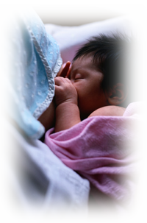


Pituitary releases
prolactin and oxytocin.
Stimulation of nerve endings in mother’s nipple/areola sends signal to mother’s hypothalamus/
pituitary.
Hormones travel via bloodstream
to mammary gland to stimulate milk production and
milk ejection reflex (let-down).
Infant suckles at the breast.
Copyright © 2003, Rev 2005 American Academy of Pediatrics
Notes:
As the infant suckles at the breast, the nerve endings in the breast send a signal to the mother’s brain, resulting in the release of prolactin from the anterior pituitary and oxytocin from the posterior pituitary.
Prolactin surges result in increased production of milk in the alveolar tissue of the breast. Oxytocin has multiple effects.
In the brain, oxytocin receptors bind the oxytocin, causing strong feelings of attachment and love for the nursing infant.
In the breast, oxytocin causes the myoepithelial cells surrounding the glandular tissue to contract and increase the milk flow to the baby, in what is called the milk ejection reflex (commonly referred to as “let-down”).
In the mother’s uterus, oxytocin causes uterine contractions that result in constriction of the myoepithelial cells of the uterus, decreasing the risk of hemorrhage. Milk production also depends on many other maternal hormones, including adequate thyroid hormone.

Slide 89
CONTRAINDICATIONS OF BREASTFEEDING
Fetal Factors:
Galactosemia.
Maternal Factors:
active untreated T.B. & H.I.V positive
T lymphotrophic virus type 1 & 2
Herpes lesion on breast
Maternal Drugs
Chemotherapy agents & antimetabolites
Drugs of abuse
Primaquine and Quinine – contraindicated if infant has G6PD

Slide 90
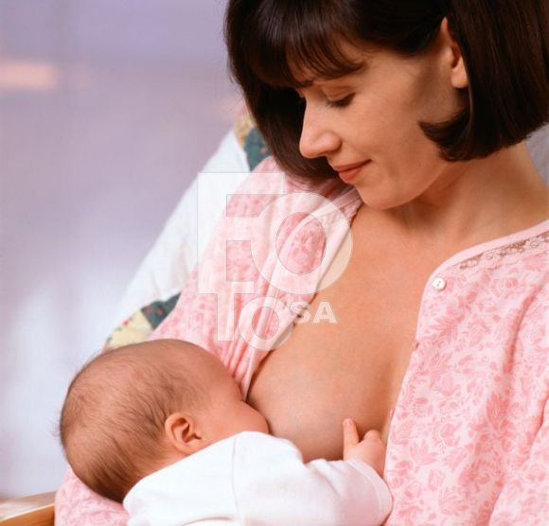
“The nature has designed the provision that infants be fed upon their mother’s milk. They find their food and mother at the same time. It’s a complete nourishment for them both for their body and soul”- Rabindranath Tagore

Slide 91


Slide 92

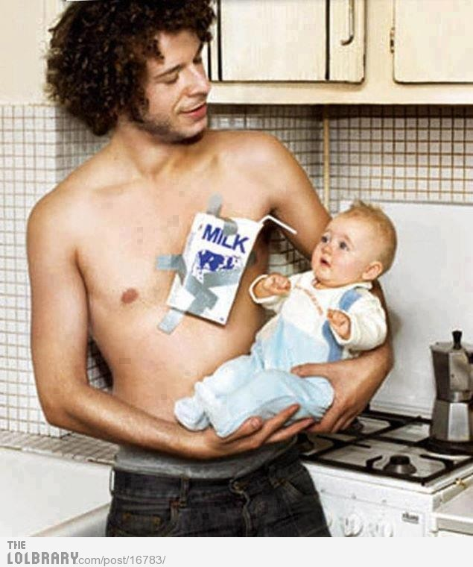

Slide 93


Slide 94


Slide 95
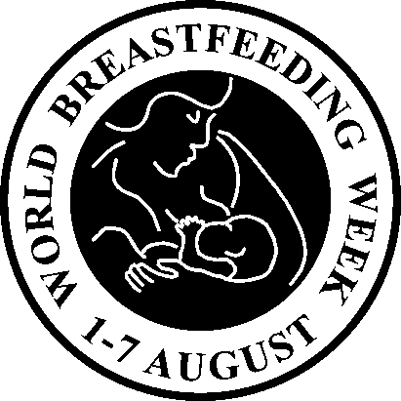
स्तनपान –अमृतसमान

Slide 96




BREASTFEED FOR FUTURE

Slide 97


Slide 98

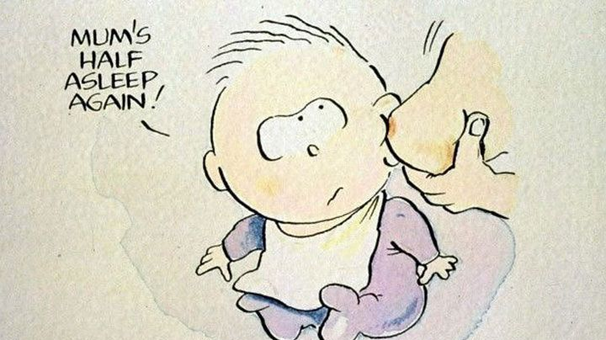

Thank You

